Slide 1
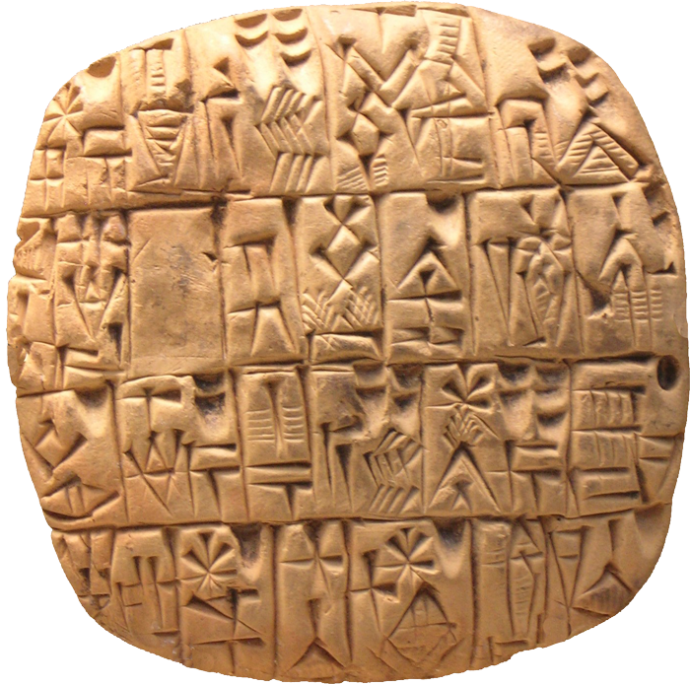
Teaching with a Tablet
Ohlone College, College Learning Week
8-24-2016, by Kit Ng, Biology Department

Slide 2
Introducing myself
Ph.D. in physiology
Adjunct at Biology department since 2015
Classes taught at Ohlone: Biol-104, 103A Lab, 130 Lab
Also teaching Anatomy & Physiology lecture and labs elsewhere

Slide 3
What would you like to know from this class?

Slide 4
Do you use a tablet? What’s your experience?

Slide 5
Experience as a student
Just reading from slide
Speaking to the chalkboard
I miss something my instructor wrote / my notes weren’t good
My instructor cannot draw!
Whiteboard teaching is very dynamic

Slide 6
Experience as an instructor
I cannot draw!
I don’t want to read from the powerpoint… but it is easy to organize slides and notes
Hard to motivate my students to go to class with powerpoint lectures.
Teaching with a tablet doesn’t substitute good teaching

Slide 7
Examples

Slide 8


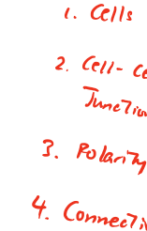
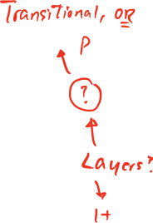













Epithelial Tissues

Slide 9
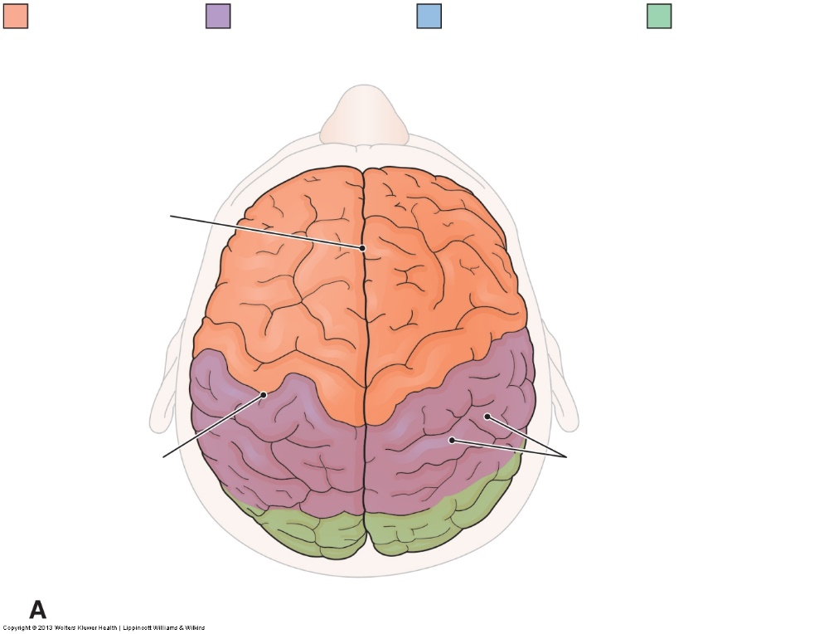

Slide 10
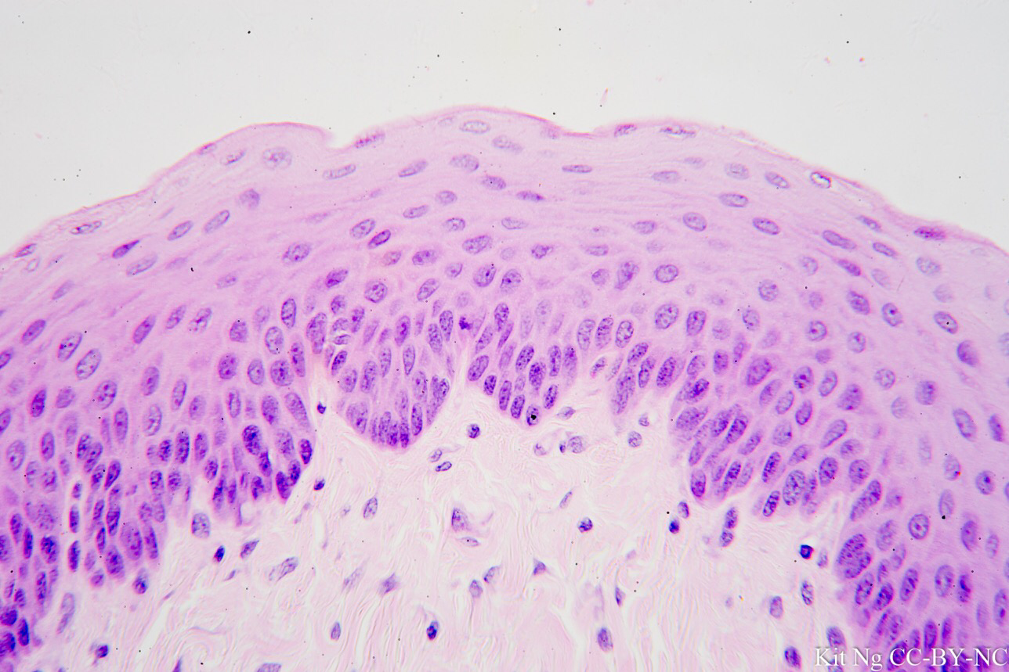
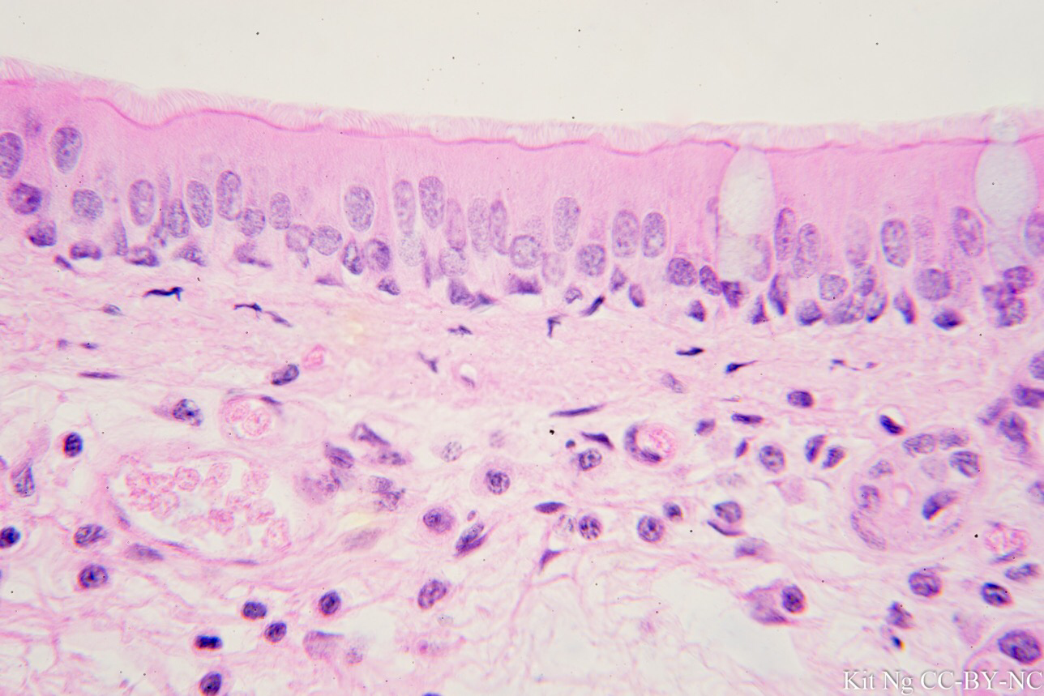
Difference between real stratified vs. pseudostratified epithelium

Slide 11
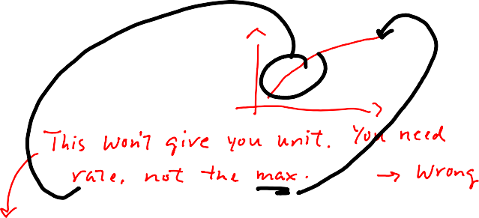




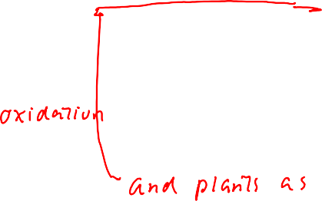




temperatures, 0˚C, room temp(25˚C), 40˚C, 65˚C, and boiling(100˚C). Then right before calculating each samples absorbance by placing it into the spectrophotometer, we added the enzyme prep to calculate immediately our enzyme activity at a controlled time. We collected the absorbance just as we did in protocol two, every 15 seconds for two minutes and then again at 3, 4, 5, 7, and 10 minutes.
Effect of pH-
We determined the effect of pH on tyrosinase activity by preparing the same dilutions as we did in protocol two and five, but instead of adding the constant 0.1 M phosphate buffer at 6pH, we added it at pH’s from 4, 5, 6, 7, 8, 9, and 10. Then collected the absorbance verse time using the spectrophotometer as well as the temperature experiment.
Results-
Our Vo vs Catechol graph showed that the highest initial velocity point was at
0.002 abs/min. Which then we calculated and gave us 2 units. Using our Lineweaver Burke plot, we calculated our Vmax to be 0.002595 Abs/min, and our Km to be 0.008423 concentration (M). Using the graphs of Vo vs temp and pH, we found our potato enzyme to have optimal specific activity at pH of 9, and temperature of 80˚C. We then used our BSA curve to calculate our enzyme protein concentration by using the 1:1000 dilution and coordinating absorbance of 0.092 to find our protein concentration of tyrosinase to be 2.79 mg/mL.
Discussion-
In our lab we experimented with the enzyme activity of tyrosinase. It is known that tyrosinase is an enzyme found in vegetable and in skin cells that polymerize substrate and lead to melanin occur. The enzyme catalyzes and transfers of sulfate from the sulfate donor adenosine to hydroxyl group of peptidyltyrosine residue to form tyrosine. It was found that tyrosine O-sulfation occurred in the trans-Golgi network, and biochemical studies showed that the enzyme was membrane-bound and its active site was oriented in the tubular (luminal) of highly enriched Golgi membranes. Tyrosine-sulfated proteins are not only found in animals, but also in prokaryotes or in yeast. Which we found in our potatoes through this experiment.
The structure of tyrosinase widely varies from animal, plant, fungi tissue with respect to primary structure, size, glycosylation pattern, and activation characteristics. There are no

Slide 12
Personal Findings
Teaching a tablet is very interactive
I can talk to students face to face
I encourage my students to take notes by hand
We are “discovering” something together
Students know what I was point at/referring to
I don’t have to carry tons of paperwork…

Slide 13
Current choices of Tablet PC

Slide 14
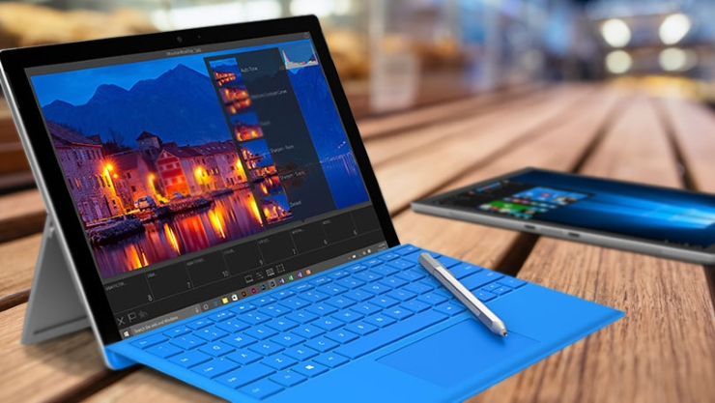
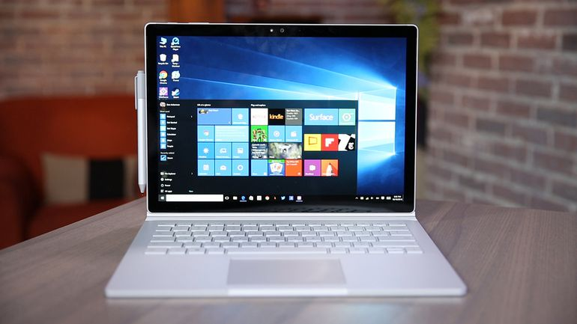
Windows – based Tablets

Slide 15
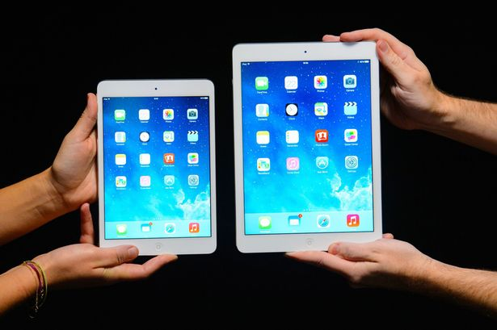
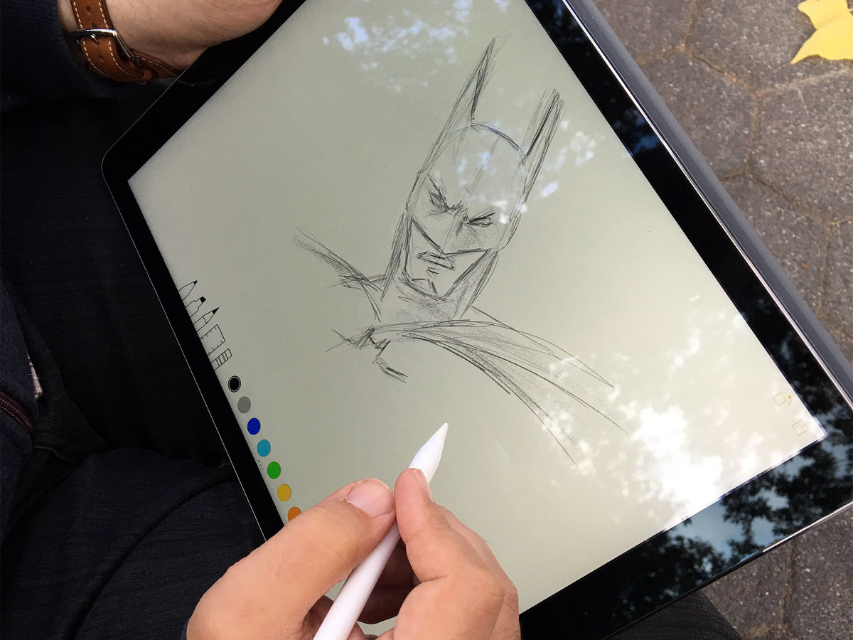
iOS-based tablets
http://i3.mirror.co.uk/incoming/article2784720.ece/ALTERNATES/s615/Apple-iPad-Mini-2-and-Apple-iPad-Air.jpg
http://www.imore.com/sites/imore.com/files/styles/larger/public/field/image/2015/11/ipad-pro-pencil-batman-hero.jpg?itok=btcP_mjk

Slide 16

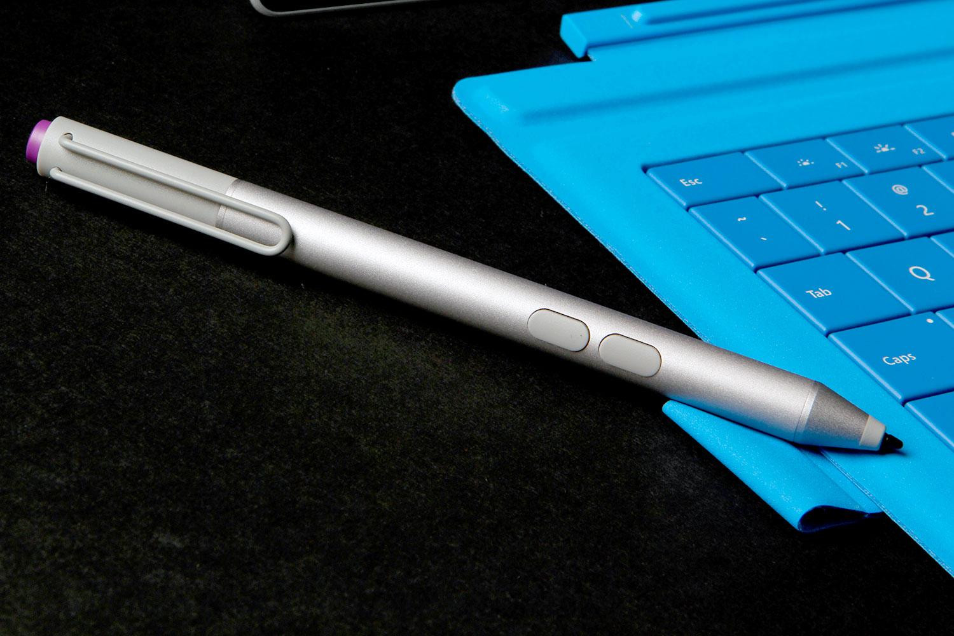
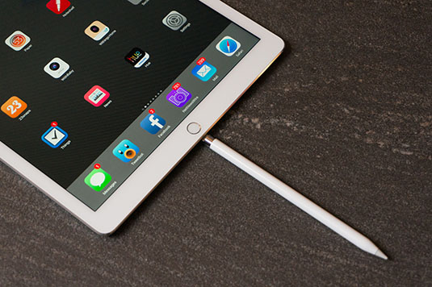
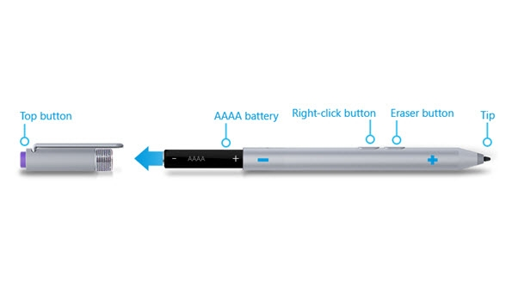
Stylus

Slide 17
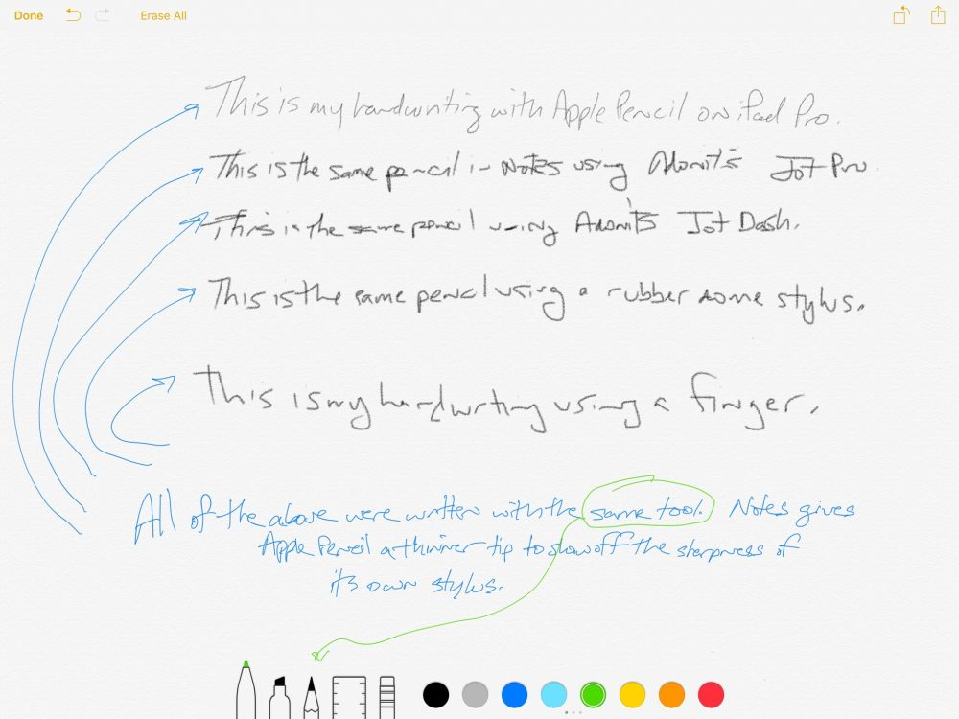
New Generation of Stylus work better than previous generations
https://9to5mac.com/2015/11/27/apple-pencil-ipad-stylus-comparison/

Slide 18
Other features
Split screen
Wireless teaching

Slide 19
Cost (for 128GB model)
 | 9.7 | 12.9-inch iPad Pro | Surface Pro 3 | Surface Pro 4 | Surface Book
Unit | $749 | $949 | $599 | $849-899 | $1349
Stylus | $99 | $99 | $60 | $60 | Included
Accessories | Keyboard: 149 Cover: 49 | Keyboard: 169 Cover 49 | Keyboard: 129 | Keyboard: 130 | Included
Total | $1046 | $1266 | $788 | $1039-1089 | $1349

Slide 20
What should I get? *Personal opinion
Notes:
Purchasing decision – 1 computer – PC/ already have computer - iPad

Slide 21
Useful Software

Slide 22





Online Storage
2GB | 5GB | 5GB | 15GB | 10GB

Slide 23

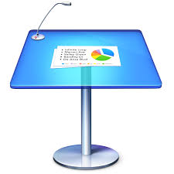



Presentation
Windows/iOS | Mac/iOS | iOS | iOS | Windows/iOS
$6.99 / month | Free with a Mac | Free | $7.99 | $6.99 / month

Slide 24


Screencasting
$7.99 | Free

Slide 25


PDF Annotation
Windows | iOS | iOS
$9.99 (but now included on Surface Pro) | $2.99 | $9.99

Slide 26

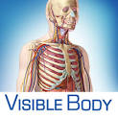


Other software

Slide 27
Biology References

Slide 28
Workflow & Demonstrations

Slide 29
Creating a lecture

Slide 30

Grading assignment

Slide 31
Explaining things

Slide 32
Questions?

