Slide 1
(SELECTED SLIDES FROM LECTURE)
Lecture 18 PNS, ANS
Bio-2205, NDNU, by Kit Ng

Slide 2
Agenda
PNS
  Cranial Nerves
  Spinal Nerves
    Plexuses
    Mapping terminal branches to muscle compartments
Autonomic Nervous System
  Sympathetic vs. Parasympathetic
Heart
  Location
  Flow schematic

Slide 3
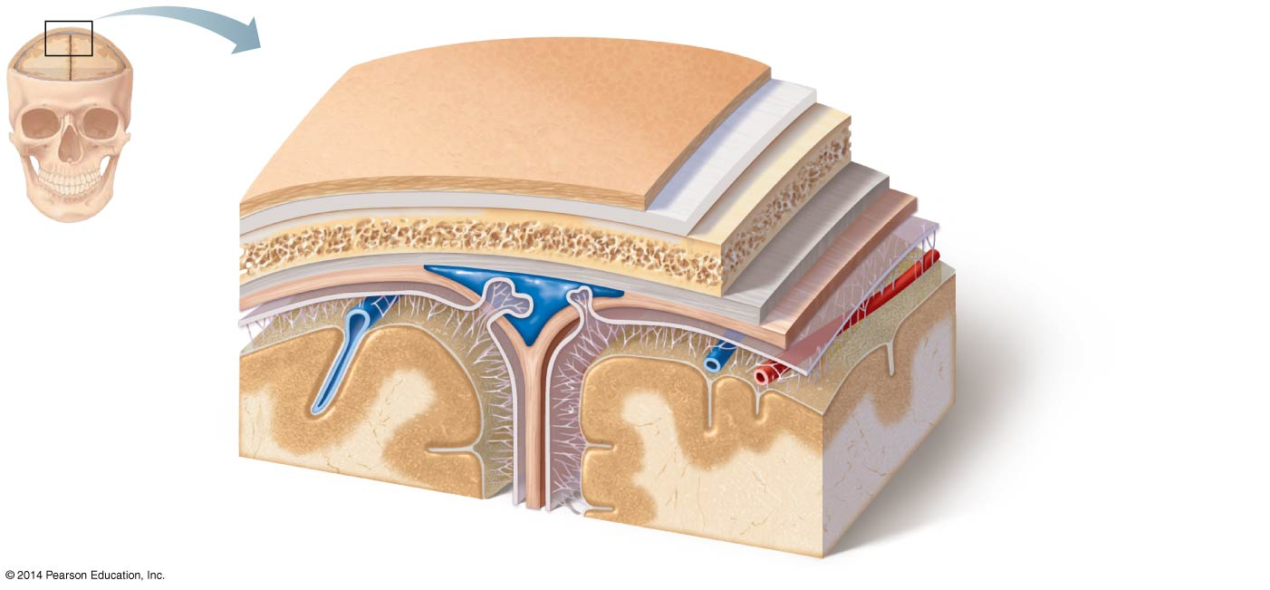
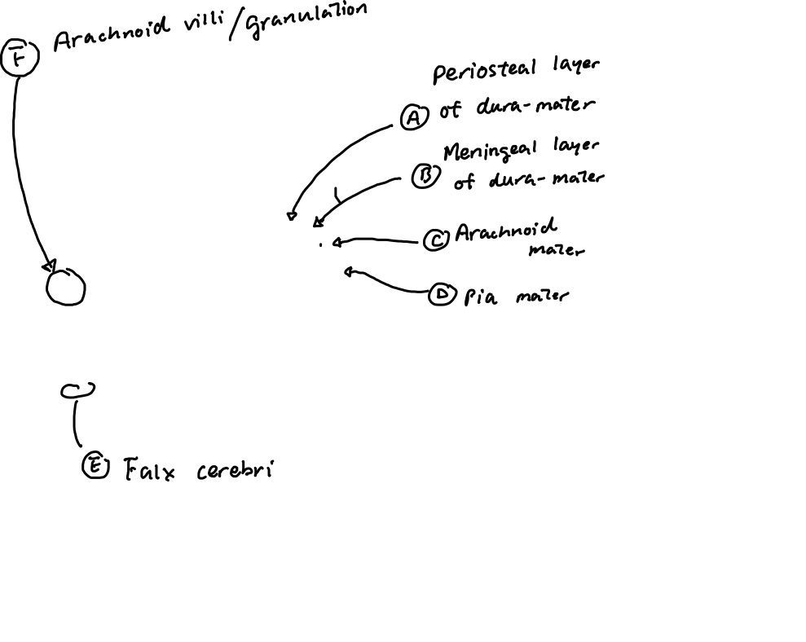
Meninges Review

Slide 4
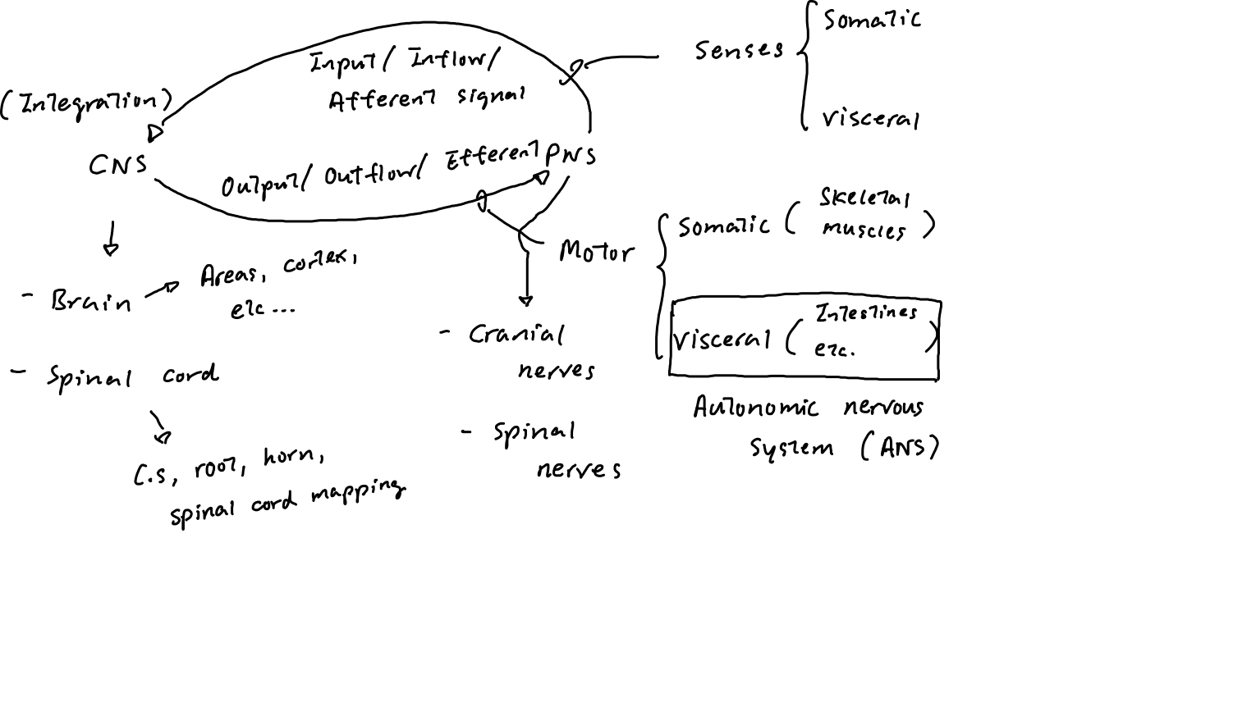
Divisions of the Nervous System

Slide 5
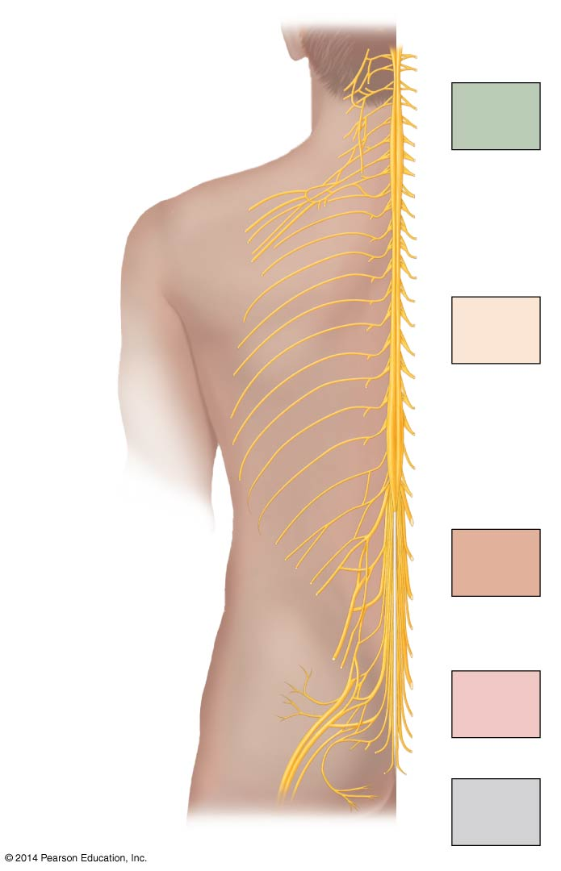
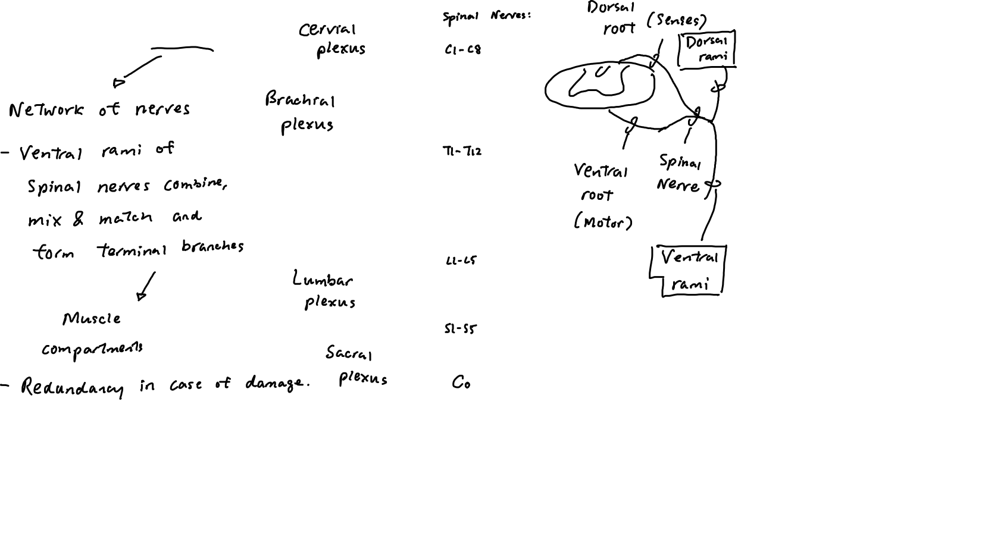
Spinal Nerves & Plexuses

Slide 6
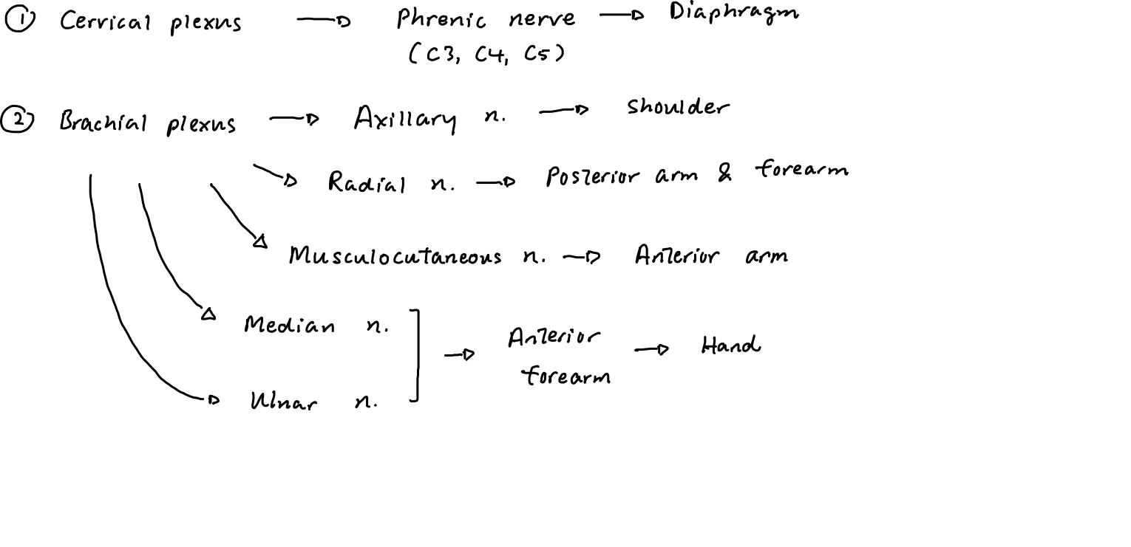
Mapping terminal branches from plexuses to muscle compartments

Slide 7
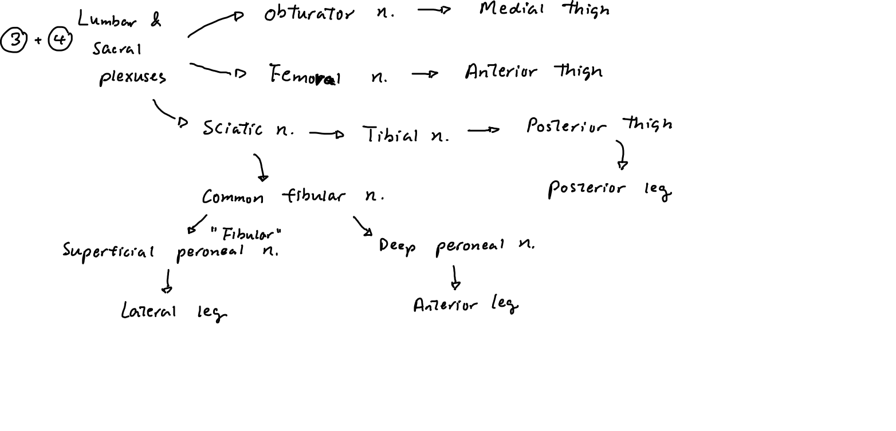
Mapping terminal branches from plexuses to muscle compartments

Slide 8
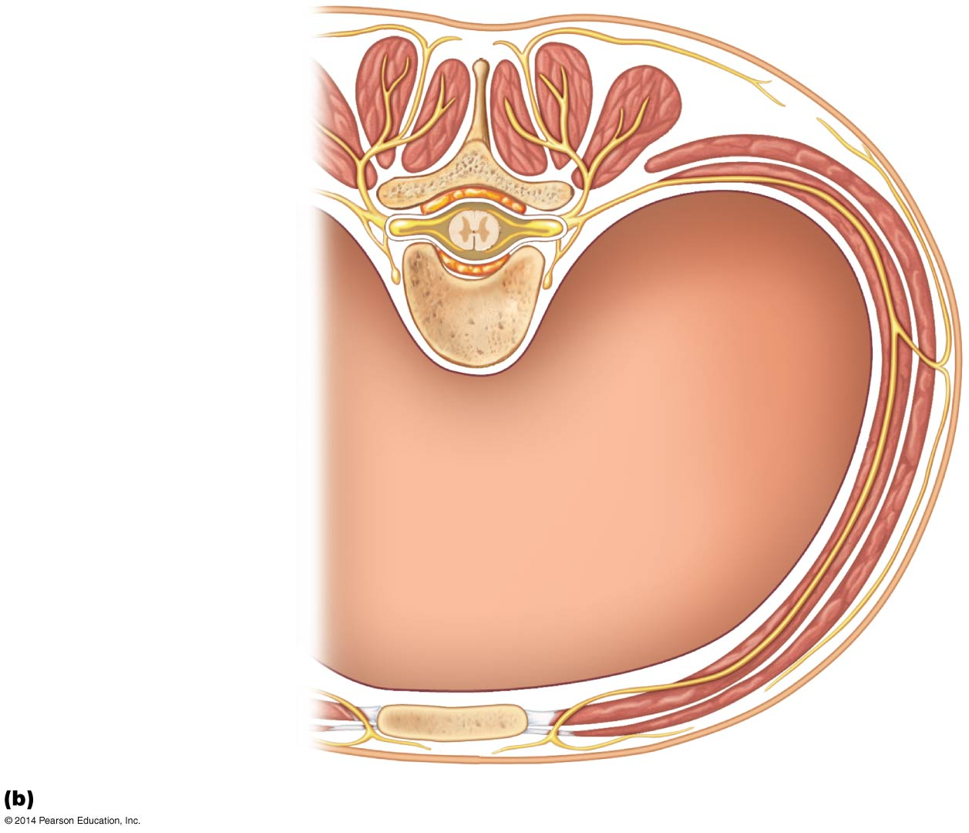
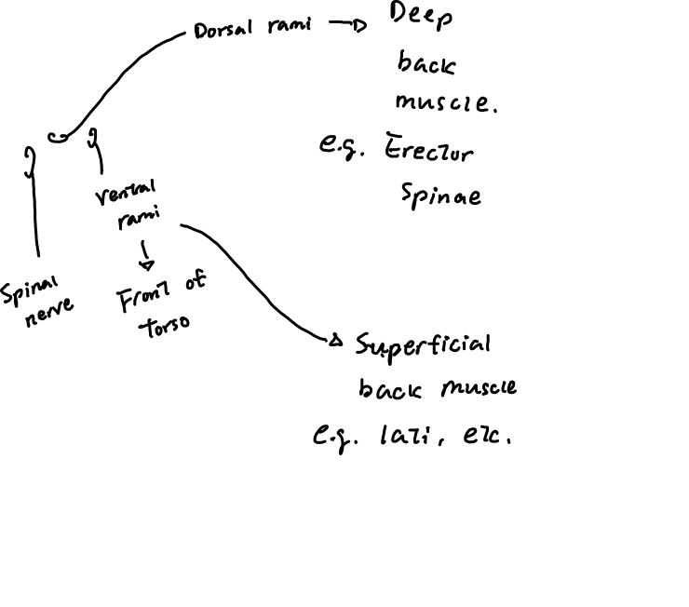
Spinal Nerves in the Thorax

Slide 9
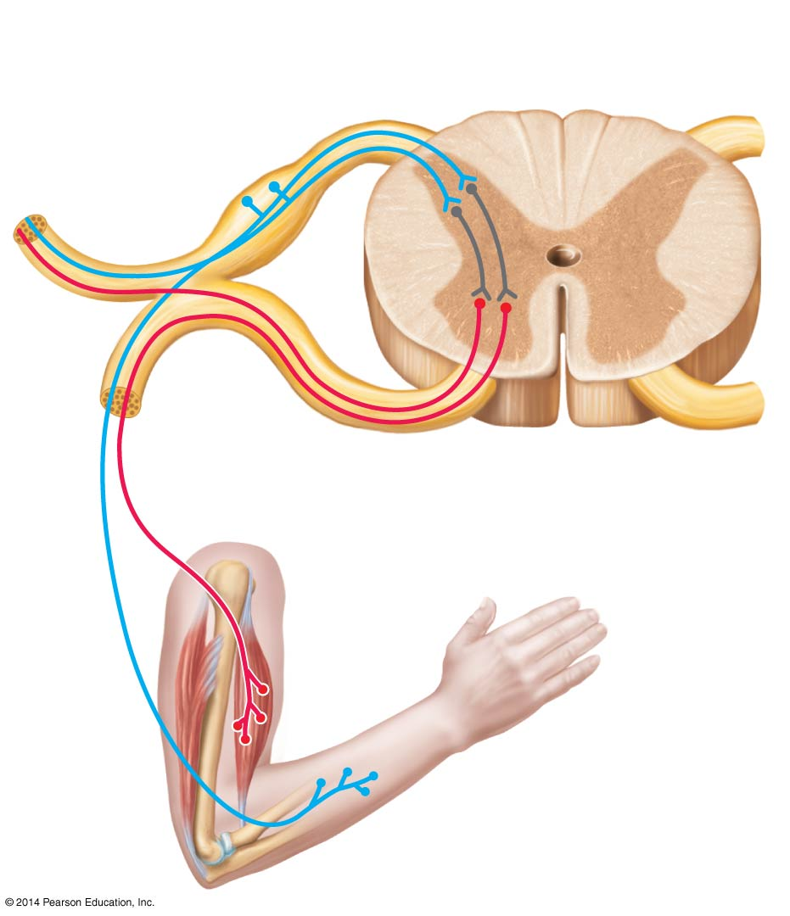
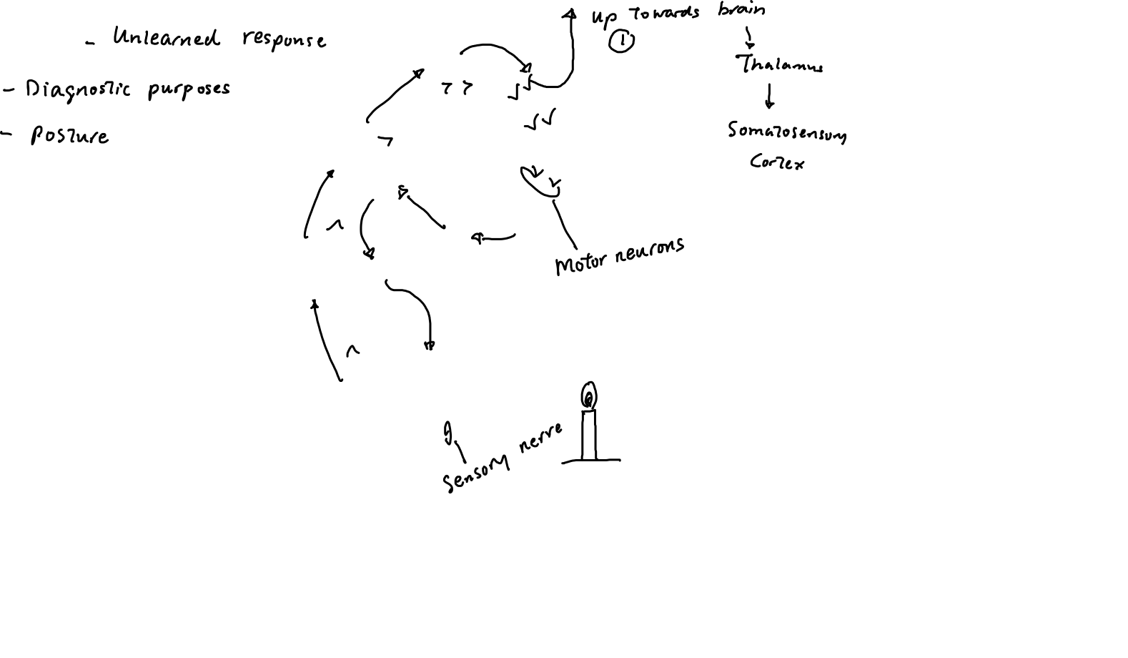
Reflexes

Slide 10
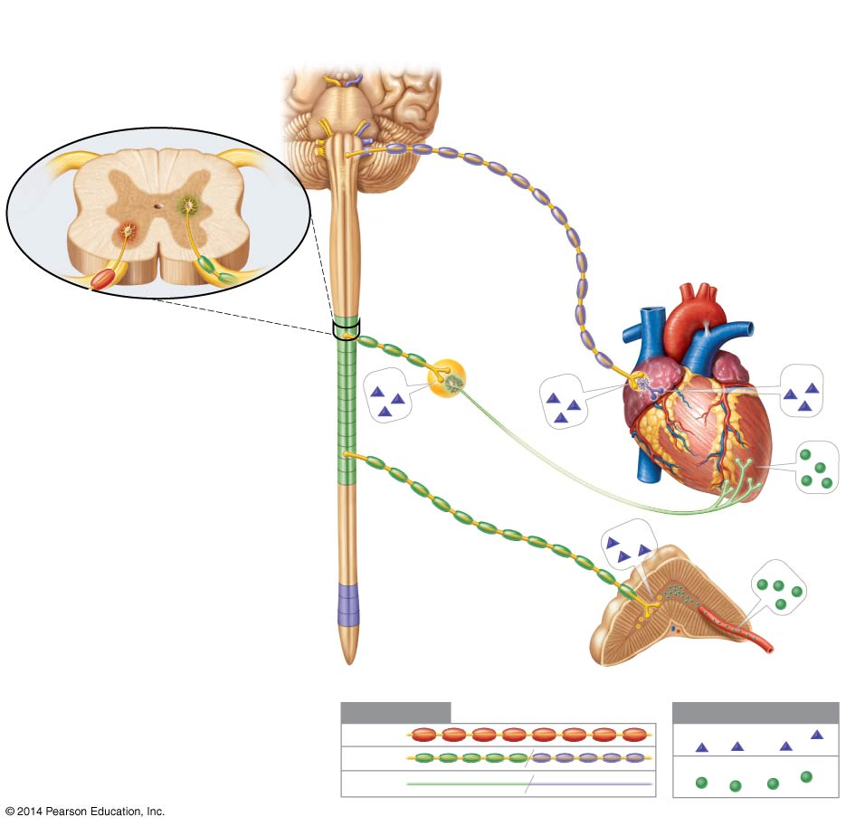
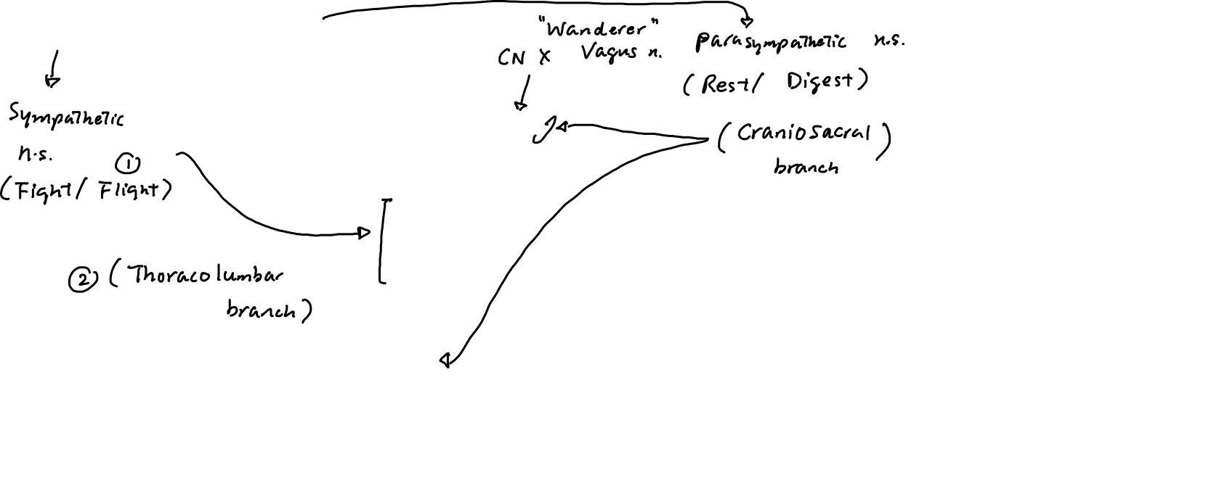
Autonomic Nervous System

Slide 11
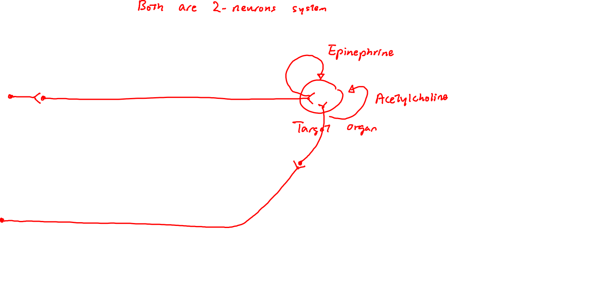
Differences in neuron arrangement between Sympathetic and Parasympathetic nervous system
Sympathetic Nervous System:
PARAsympathetic Nervous System:

