Slide 1
(SELECTED SLIDES FROM LECTURE)
Lecture 18 PNS, ANS
Bio-2205, NDNU, by Kit Ng

Slide 2
Agenda
PNS
  Cranial Nerves
  Spinal Nerves
    Plexuses
    Mapping terminal branches to muscle compartments
Autonomic Nervous System
  Sympathetic vs. Parasympathetic
Heart
  Location
  Flow schematic

Slide 3
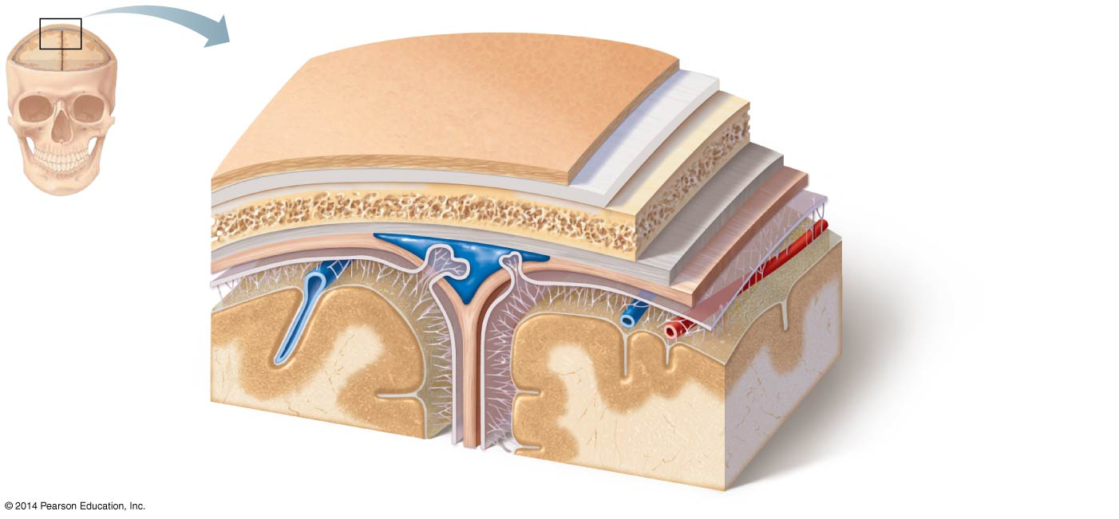
Meninges Review

Slide 4
Divisions of the Nervous System

Slide 5
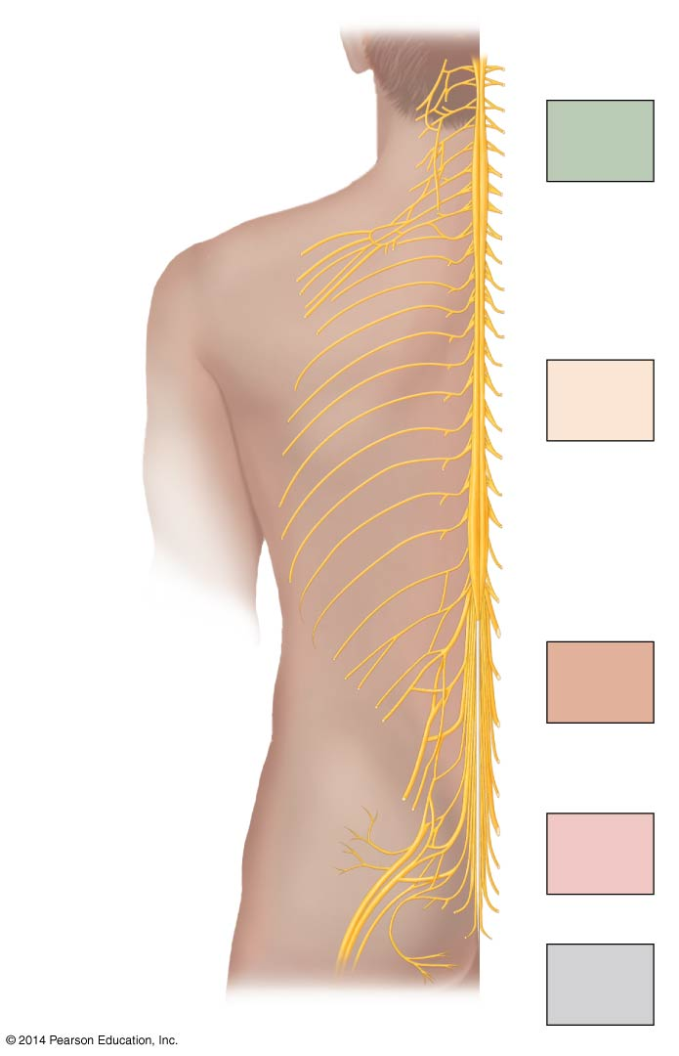
Spinal Nerves & Plexuses

Slide 6
Mapping terminal branches from plexuses to muscle compartments

Slide 7
Mapping terminal branches from plexuses to muscle compartments

Slide 8
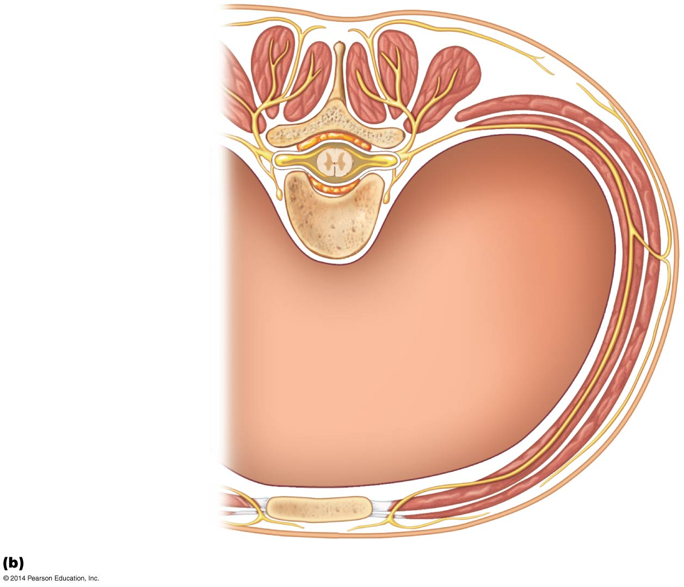
Spinal Nerves in the Thorax

Slide 9
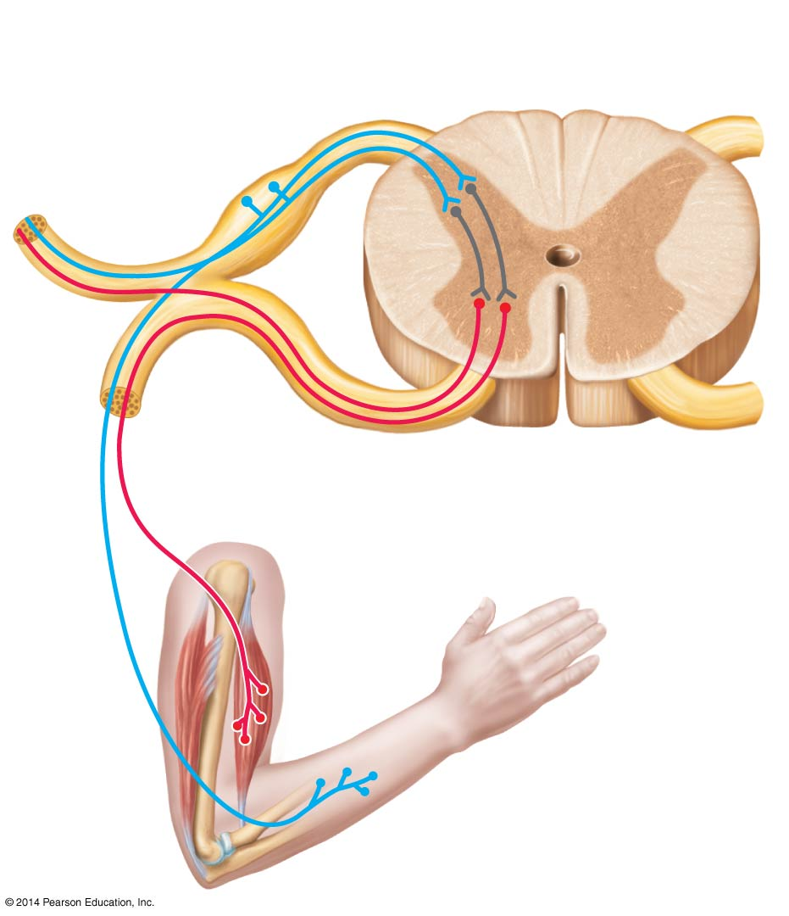
Reflexes

Slide 10
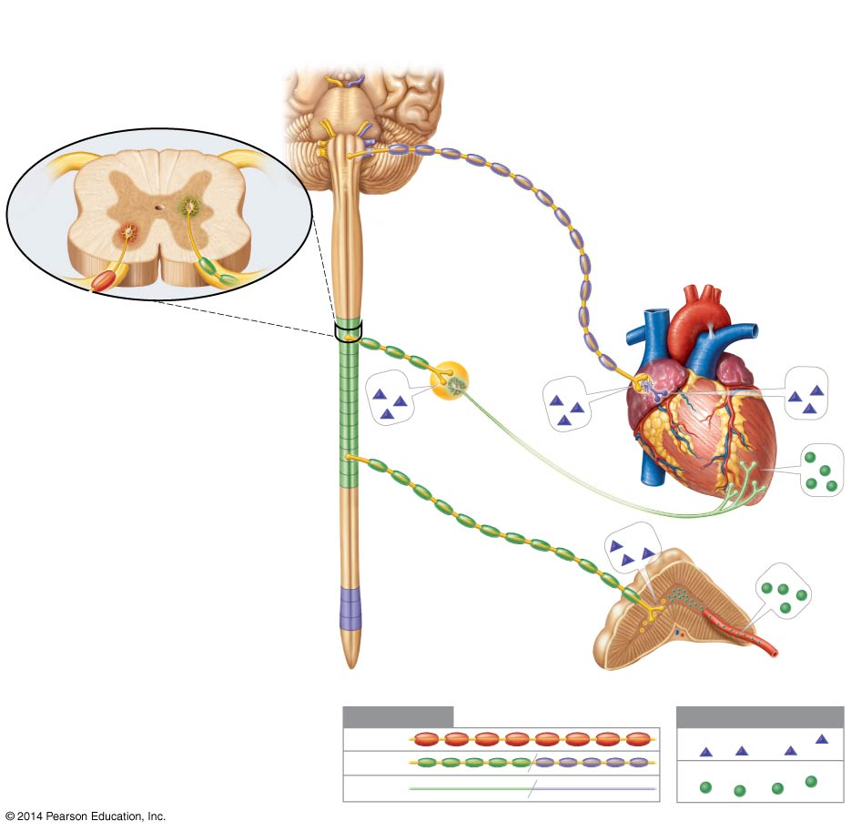
Autonomic Nervous System

Slide 11
Differences in neuron arrangement between Sympathetic and Parasympathetic nervous system
Sympathetic Nervous System:
PARAsympathetic Nervous System:

