Slide 1
Resume Workshop
By Kit Ng
NDNU, natural sciences

Slide 2
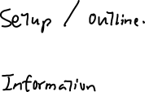
What do you hope to learn today?

Slide 3
Why a resume/cv?
Applying for jobs
Applying for graduate programs
Requesting recommendation letter and references
Reflecting on your experiences within and without school

Slide 4
You want to start your resume ahead of deadline

Slide 5
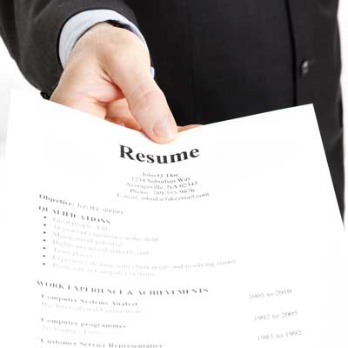
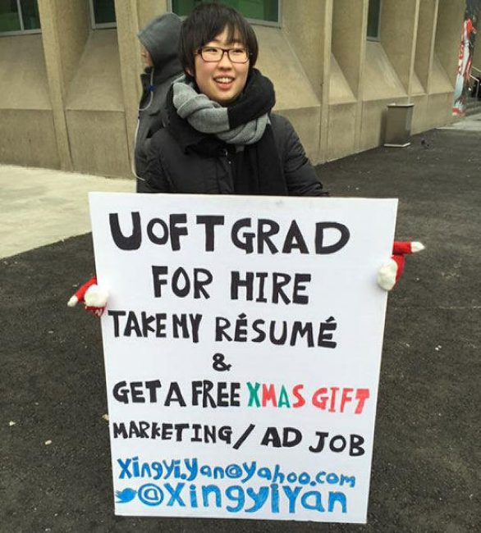
First impression is important
https://adaquest.com/wp-content/uploads/2012/10/Resume.jpg
https://images.thestar.com/content/dam/thestar/news/gta/2014/12/18/u_of_t_grad_takes_job_hunt_to_the_street/542xingyiyanjpg.jpg.size-custom-crop.0x650.jpg

Slide 6
Outline
Differences between a CV and a resume
Gathering the ingredients
Writing a resume
Writing a CV

Slide 7
Resume
“Summary” in French
SELECTIVE list that is specific for the job you are applying
Ideally 1 page, at most 2.
Your effectiveness in transferring previous skills to a job
Non-academic jobs

Slide 8
CV
Curriculum vitae
Course of life
COMPREHENSIVE list of every activity and achievement
No limit on length
Academic jobs

Slide 9
Different presentations of the same ingredients (you!)

Slide 10
“Ingredients”
Contact information
Qualifications Summary
Education
Projects
Honors, Awards, and activities

Slide 11
“Ingredients”
Experience
Leadership Activities
Publications/Presentations
Research Techniques/Skills

Slide 12
Suggested format for a resume
Name
  Contact information
Qualifications Summary
Education
  Degree, graduation date
  Institution, City and State
  GPA (optional)
  Representative coursework
Experience
  Position, date
  Company, City and State
Projects
Skills

Slide 13
Qualifications summary
Substitute objectives
Highlight your strengths and what you can offer.

Slide 14
Qualifications summary
(E.g. 1) Accomplished driver of diversified projects in the governmental, educational and non-profit fields. Exceptional communications skills coupled with the capacity to assimilate, shape and use large stores of information quickly. Possess an extensive background in the following broad-based competencies:
(E.g. 2) Enthusiastic, hard-working, flexible team player with immunology PhD, RAC certification, and experience writing submissions for a diverse group of pharmaceutical clients, looking for a new challenge and more responsibility in biologics-focused medical writing in the Washington DC area
Excerpted from samples at University of Pennsylvania Career Services website

Slide 15
Qualifications summary
(E.g. 3) Experienced R&D instrumentation electrical engineer with expertise in highpower and low-noise electronics, mechanical and algorithms development, and team management. Broad scientific knowledge across electromagnetics, circuit design, signal processing, RF, and embedded systems. Responsibilities across all stages of research and development, specializing in concept prototyping. Excellent communicator; quick learner.

Slide 16
Tailor your resume to what you apply for

Slide 17
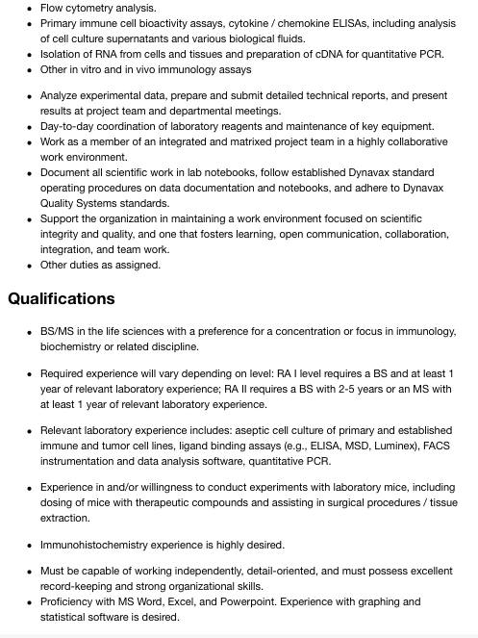
What are you applying for?
Research Associate I, B.S level

Slide 18
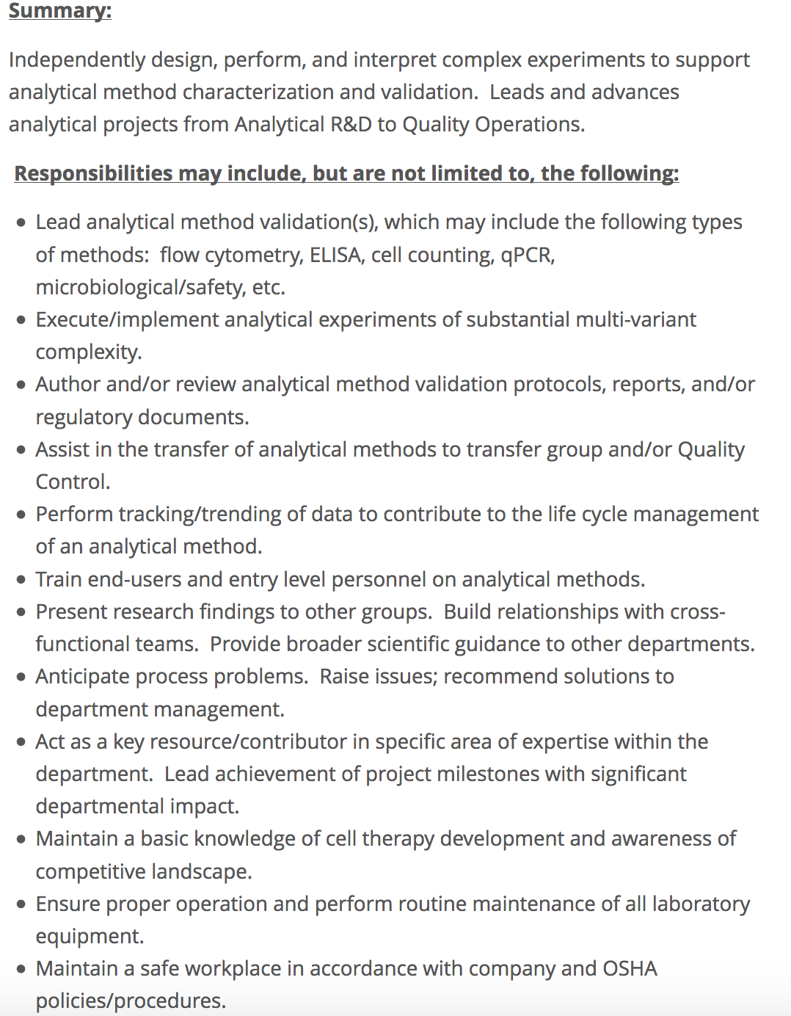
What are you applying for?
Bio-Engineer, B.S. to M.S. level

Slide 19
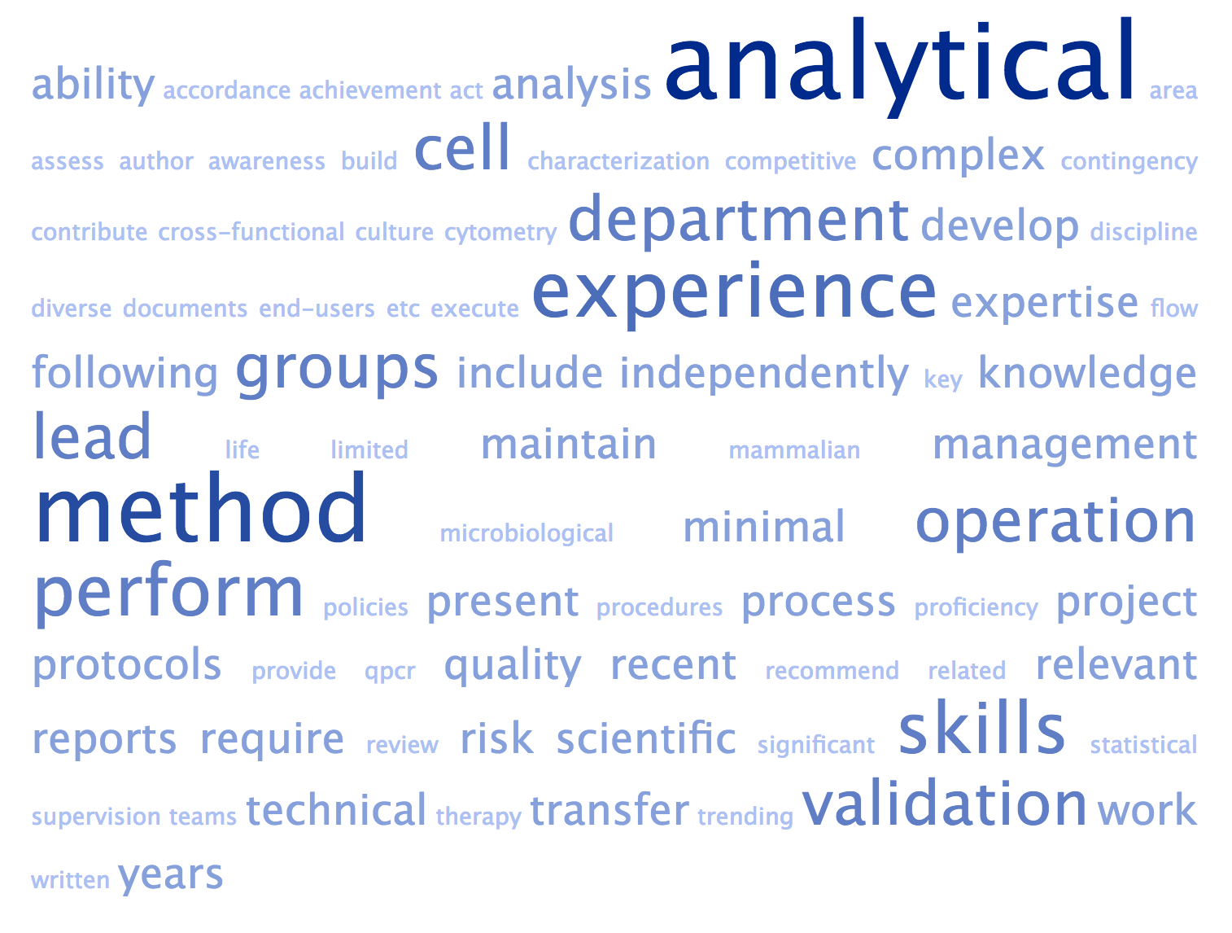
So… what are they looking for?
Created using tagcrowd.com
Bio-Engineer, B.S. to M.S. level

Slide 20
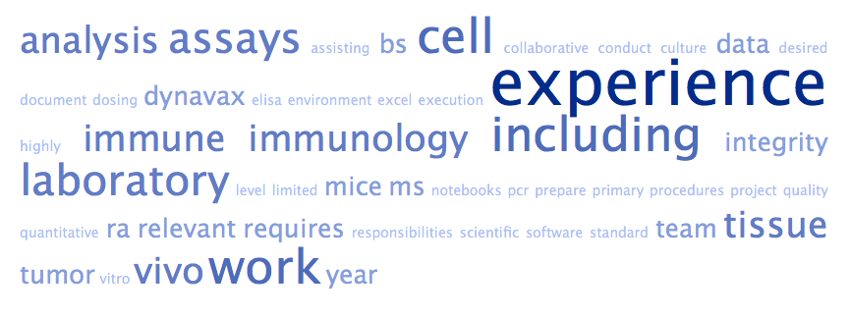
So… what are they looking for?
Created using tagcrowd.com
Research Associate - 1

Slide 21
Transferable skills
Think of what you have done and translate them into what the position requires.
How and what you did over content of experience
Summary of what I did:
Conducted animal study to clarify and support the correlation between dyslipidemia and Alzheimer’s Disease. Relevant techniques and findings have been published in two manuscripts.
Resume:
Designed MRI protocol in conjunction of animal model
Published the technique and the findings in 2 peer-review journal articles
Collaborated with 2 laboratories to refine experimental and analysis protocols
Coordinated with multiple campus facilities to ensure timely completion of experiments
Mentored 2 undergraduate researchers
Complied with animal use protocol outlined by IACUC

Slide 22
Action Verb + context (some examples)
COLLABORATED with researchers from 3 laboratories.
DESIGNED experimental protocol.
RESPONDED to client feedback in a timely manner.
DEFINED the parameters of experiment to ensure efficient analysis
PREPARED weekly oral presentations
PRIORITIZED and DELEGATED tasks to team of 6 students weekly

Slide 23
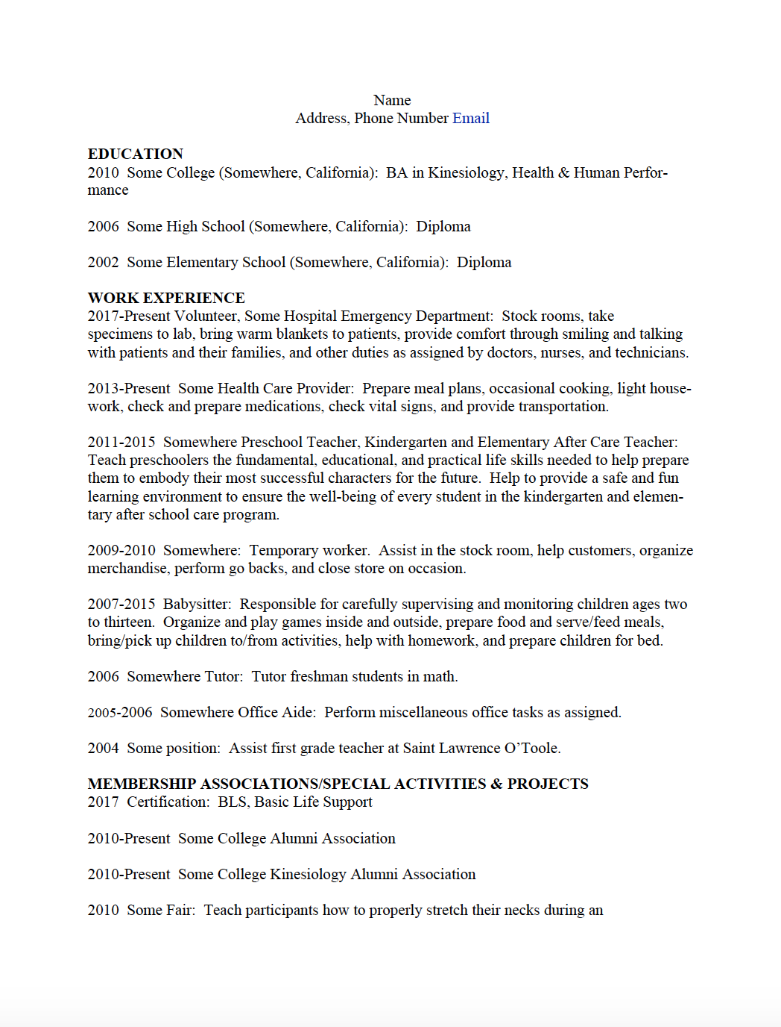
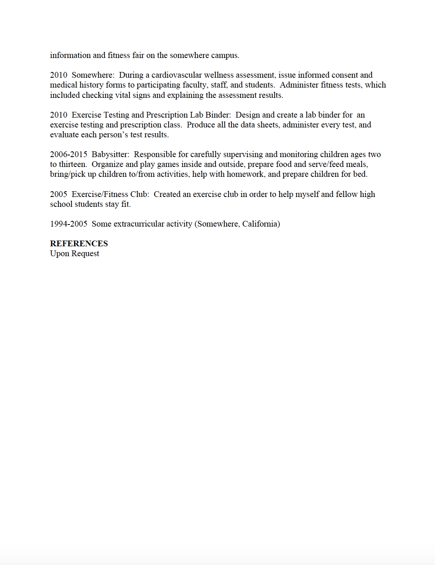
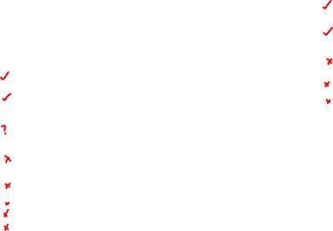
Resume example 1

Slide 24
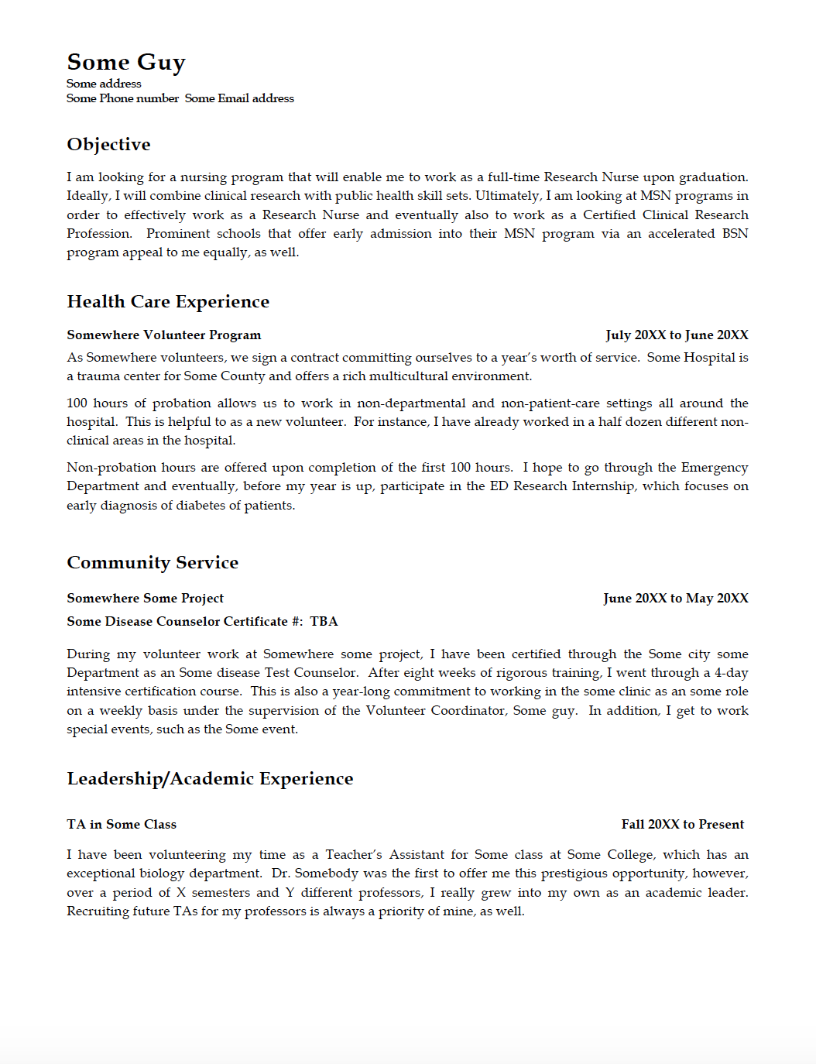
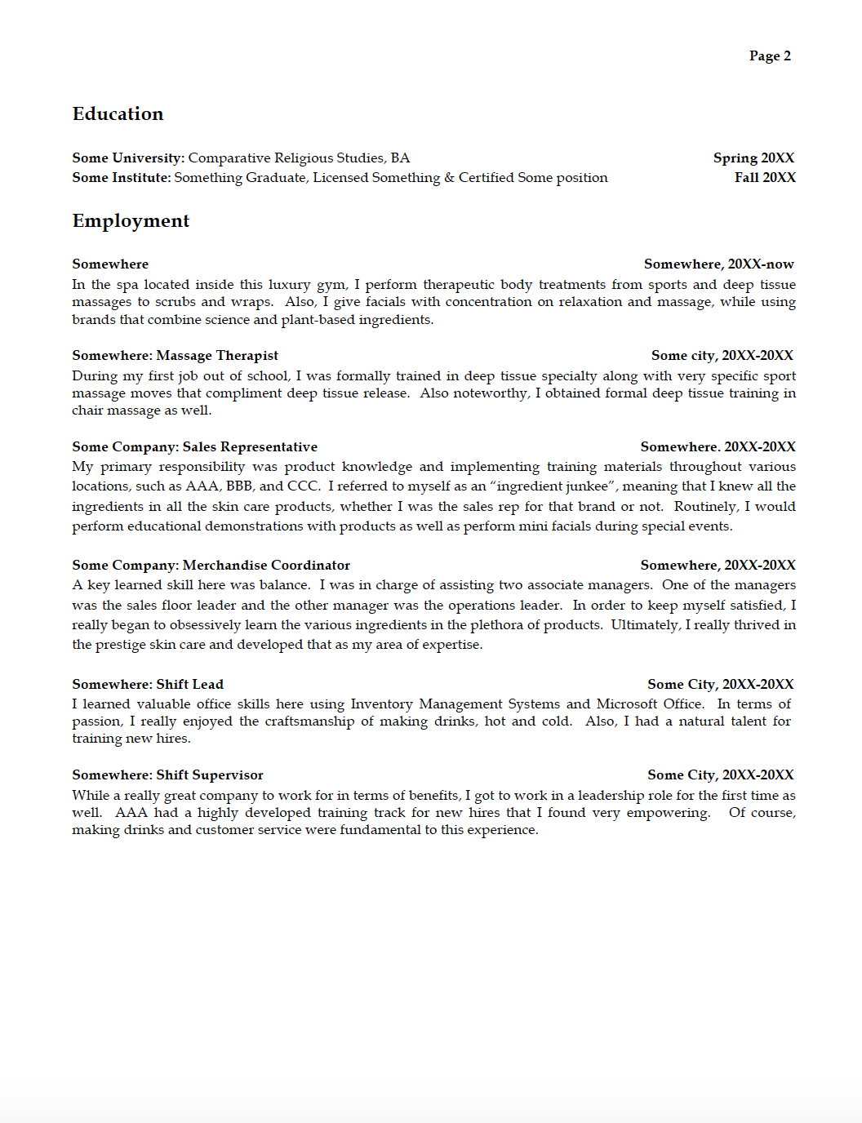
Resume example 2

Slide 25
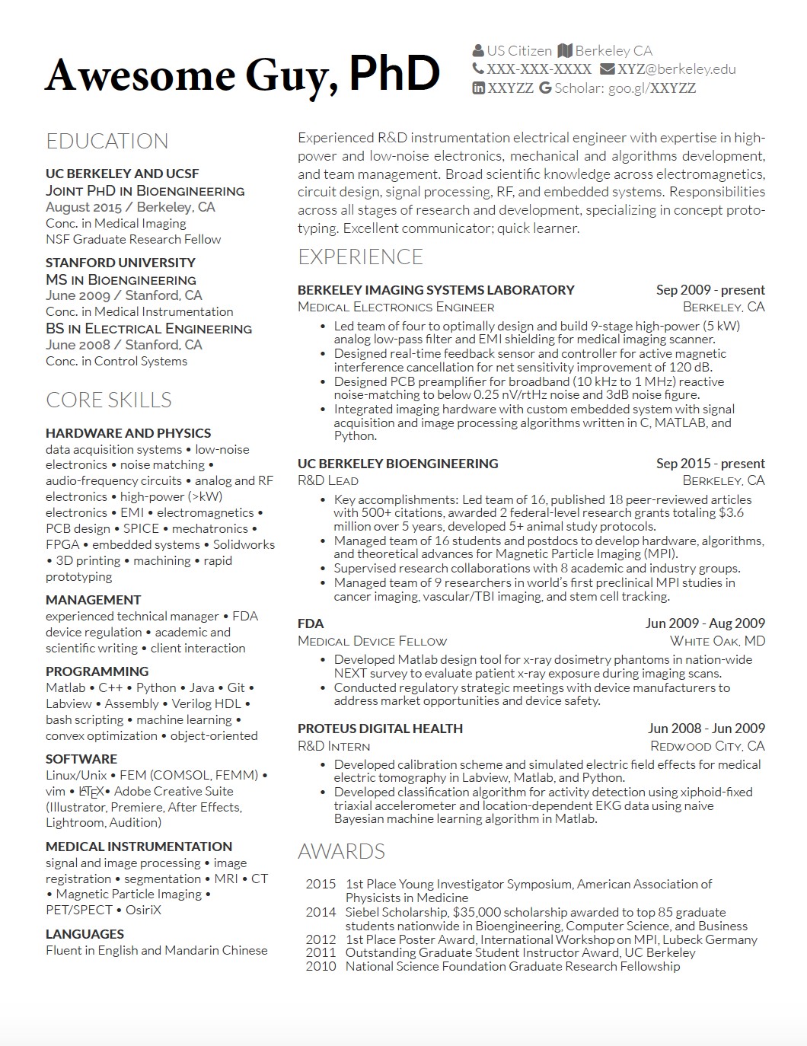
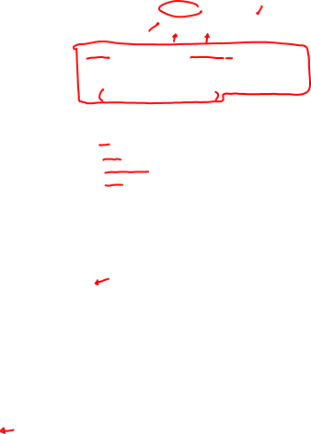
Resume Example 3

Slide 26

Additional tips on resume
Keep formatting simple (1-inch margin)
Use standard fonts – Arial, Courier and Times New Roman (10-12 pt font)
Submit resume in word doc (doc) or rich text format (rtf)
Use bold, italics, all caps, indenting and traditional bullets to organize the resume.
Use both the acronym and spelled-out form. E.g. Certified Public Accountant (CPA)
Use tagcrowd to figure out important keywords
Notes:
Applicant Tracking System require cold conformity and simplicity. Therefore, you’ll need to delete any extra touches you’ve added to your resume, like logos, pictures, symbols, and shadings.
Use standard fonts to not confuse ATS
Some ATS doesn’t do well with PDF

Slide 27
Additional tips on resume
Include verb, skills and qualifications written in the job description in the resume
Print on quality bond paper and stick with white or off-white colors.
Select only the most related experiences.
Organize the resume so that the most relevant and most recent information is at the top.
Spell check, spell check and spell check, but rely more than the word processor
Notes:
Applicant Tracking System require cold conformity and simplicity. Therefore, you’ll need to delete any extra touches you’ve added to your resume, like logos, pictures, symbols, and shadings.
Use standard fonts to not confuse ATS
Some ATS doesn’t do well with PDF

Slide 28
references
University of Pennsylvania Career Services (https://www.vpul.upenn.edu/careerservices/)
Tagcrowd.com
https://www.themuse.com/advice/beat-the-robots-how-to-get-your-resume-past-the-system-into-human-hands
https://www.insidehighered.com/blogs/gradhacker/intro-resumes-cv-minded-academics
https://www.livecareer.com/quintessential/transferable-skills-technique
CV Writing Handout. UC Davis Internship and Career Center
PhD transferable skills. University of Michigan University Career Center
Kelsky, Karen. The Professor is in.

Slide 29
Suggested format for a CV
Name
  Contact information
Professional Appointments
Publications
  Start with your most recent publication
  Bold your name in the list of authors
Awards and Honors
Grants and Fellowships

Slide 30
Suggested format for a CV (Con’t)
Invited Talks
Conferences
Campus or Departmental Talks
Teaching Experience
Research Experience
Services
Professional Development
Related skills
Professional Memberships
References

Slide 31
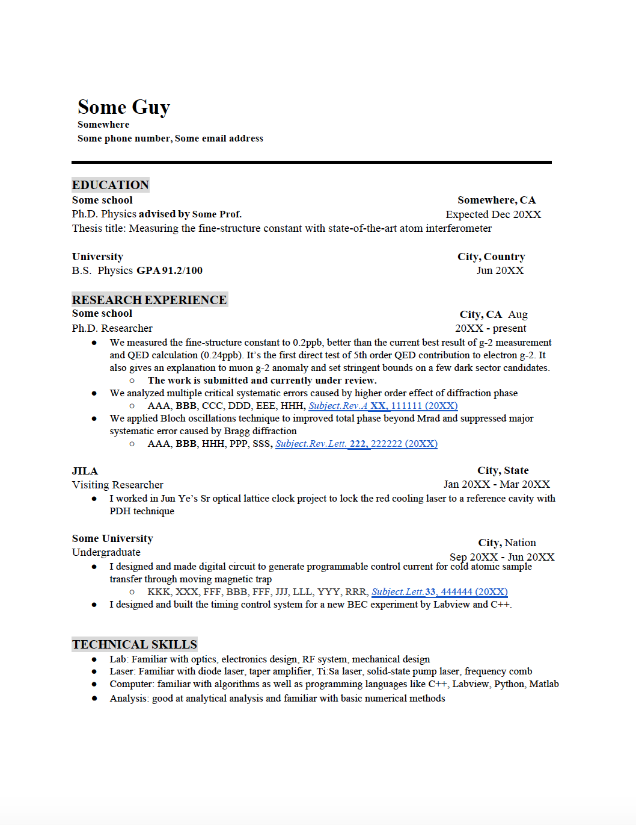
CV Example

Slide 32
Some formatting tips for cv
One-inch margins
12-point types
Single-spaced
Headings in bold and all caps
Subheading in bold only
Year of each entry is left-justified
One sentence summary if needed
Sequence of sections can change as needed
Consistency is the key

Slide 33
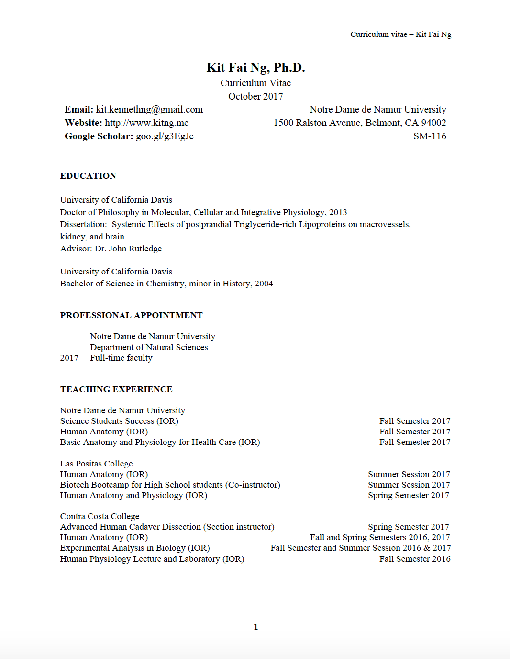
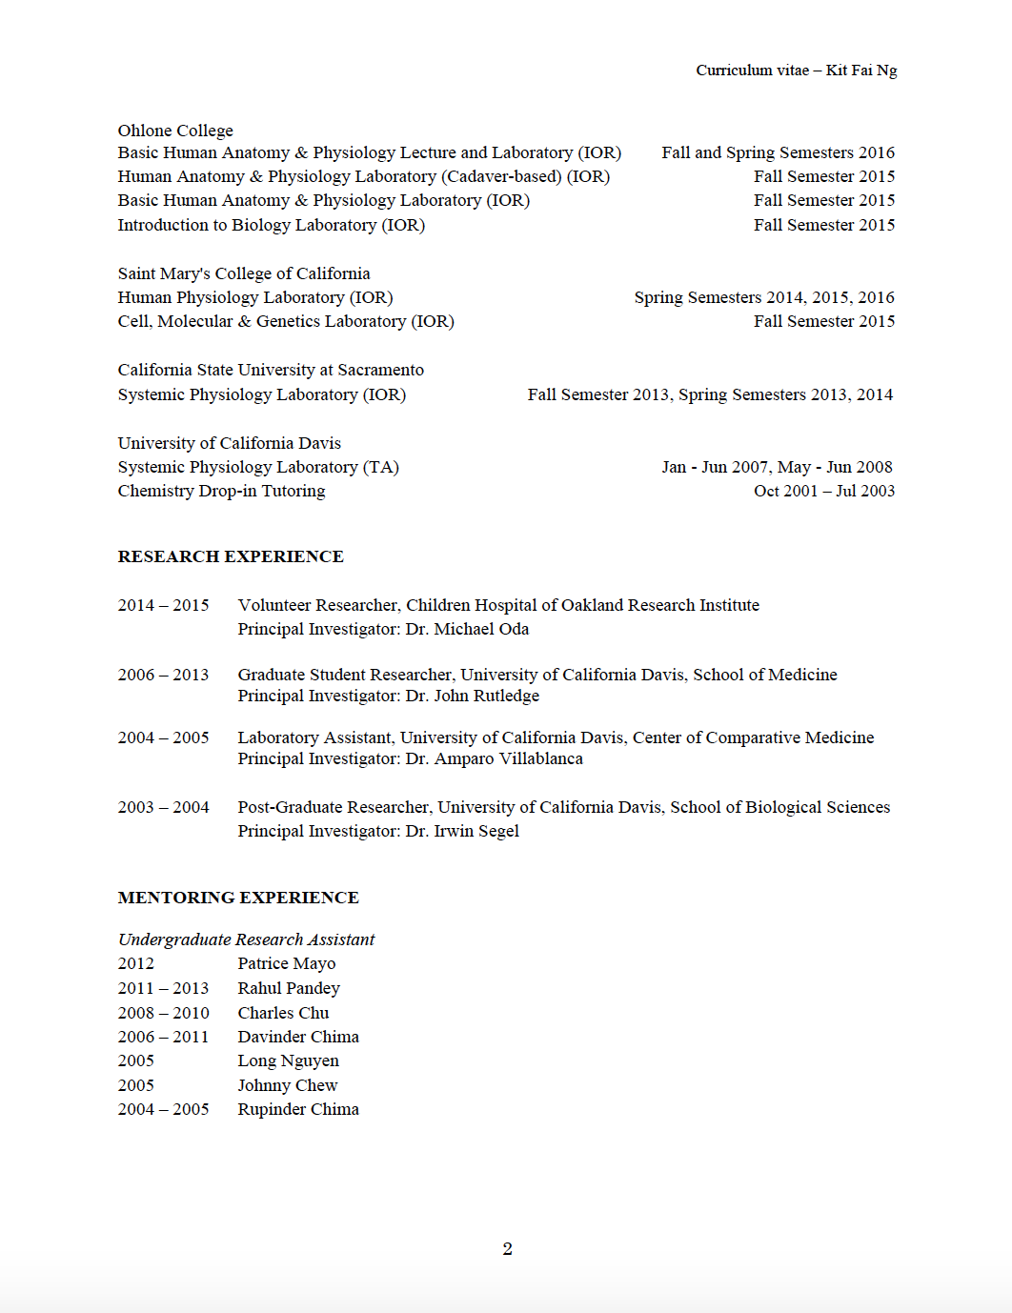
Teaching cv

Slide 34
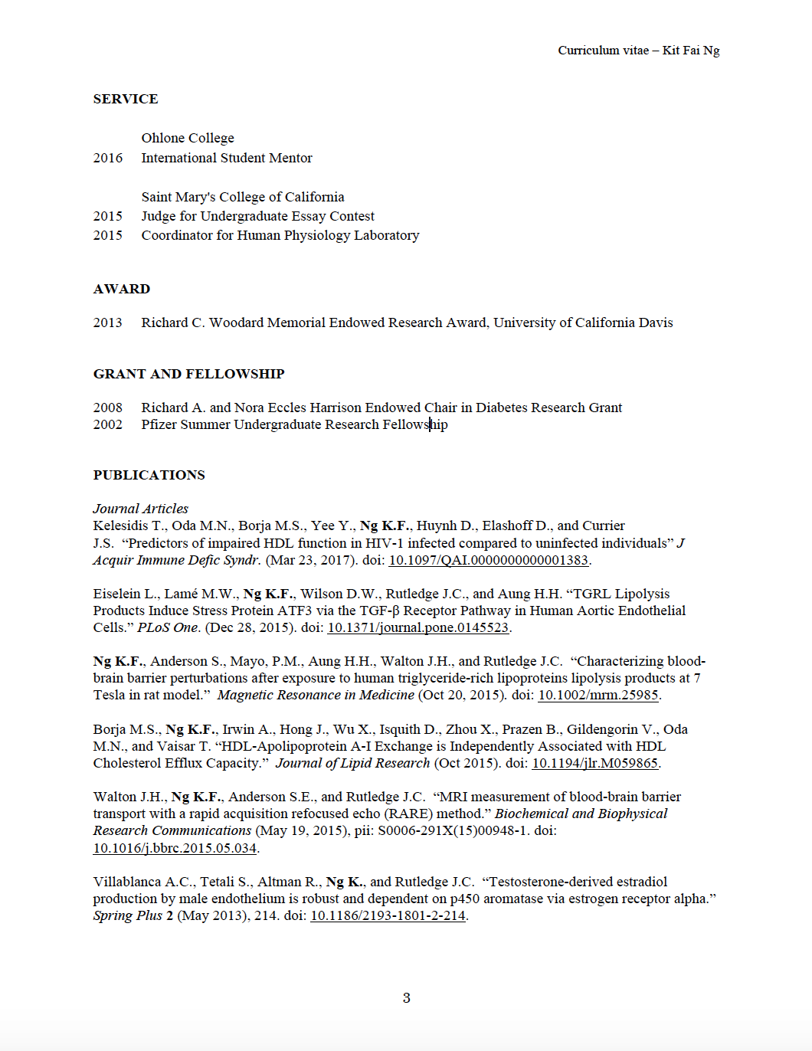
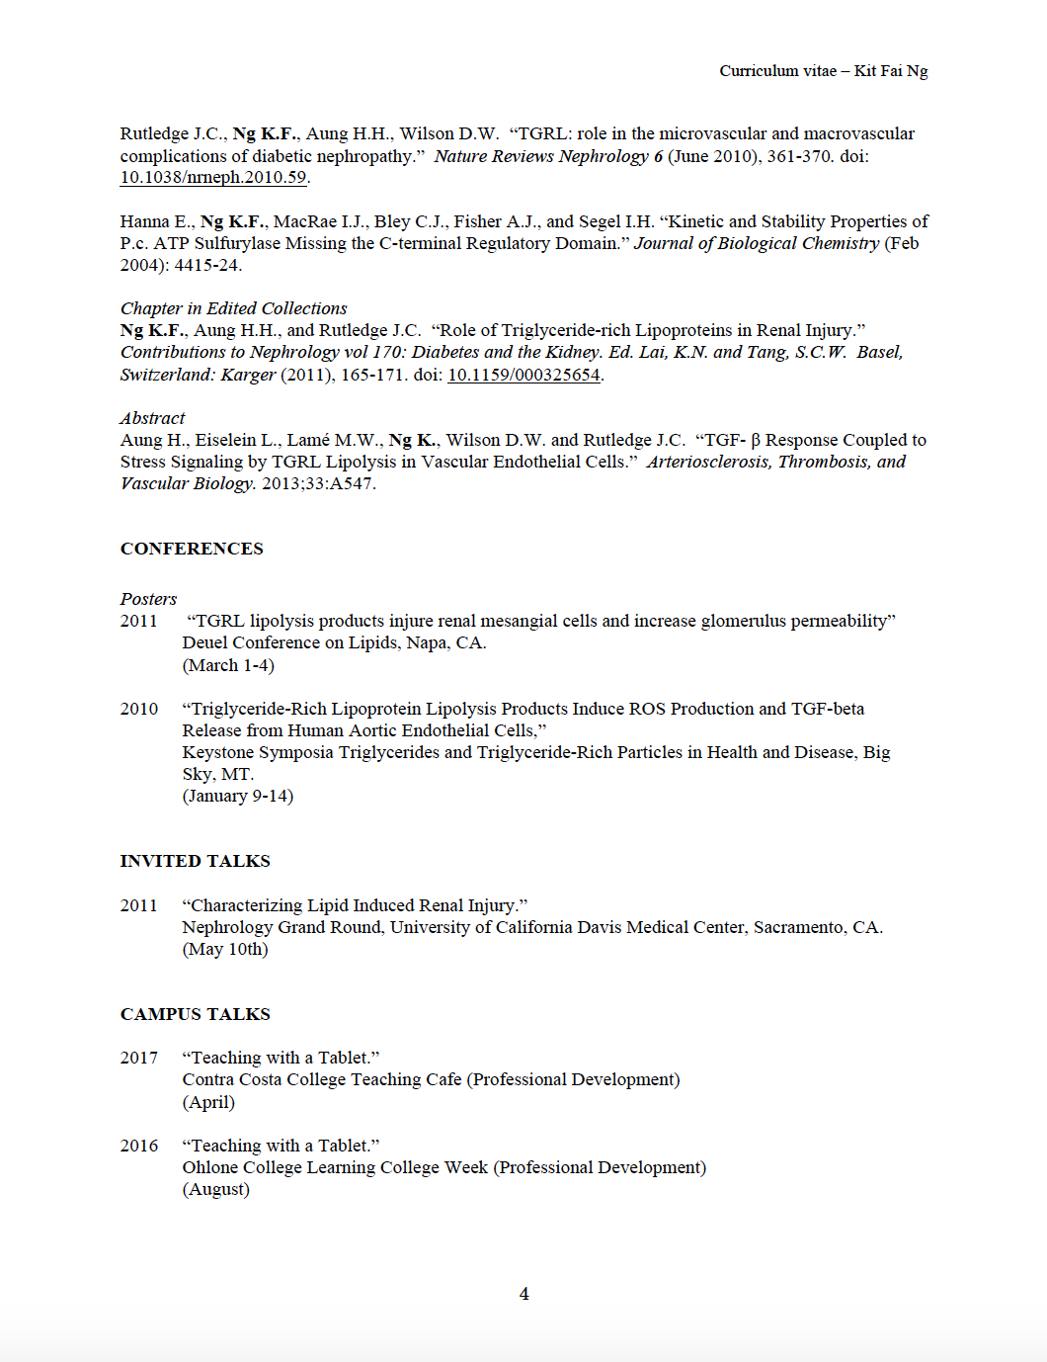
Teaching cv

Slide 35
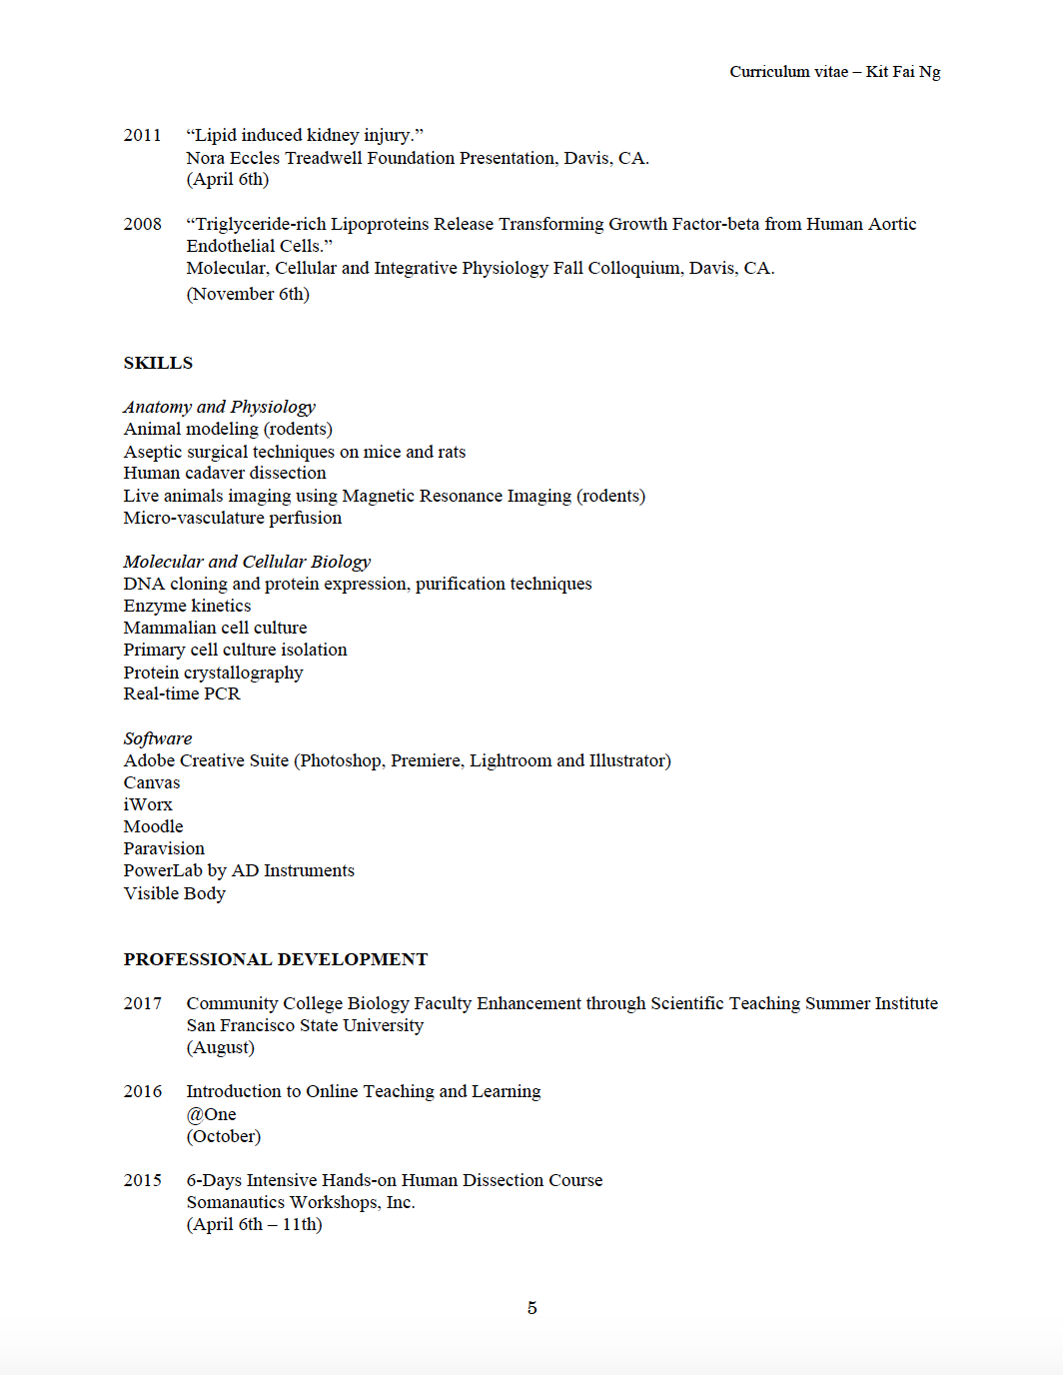
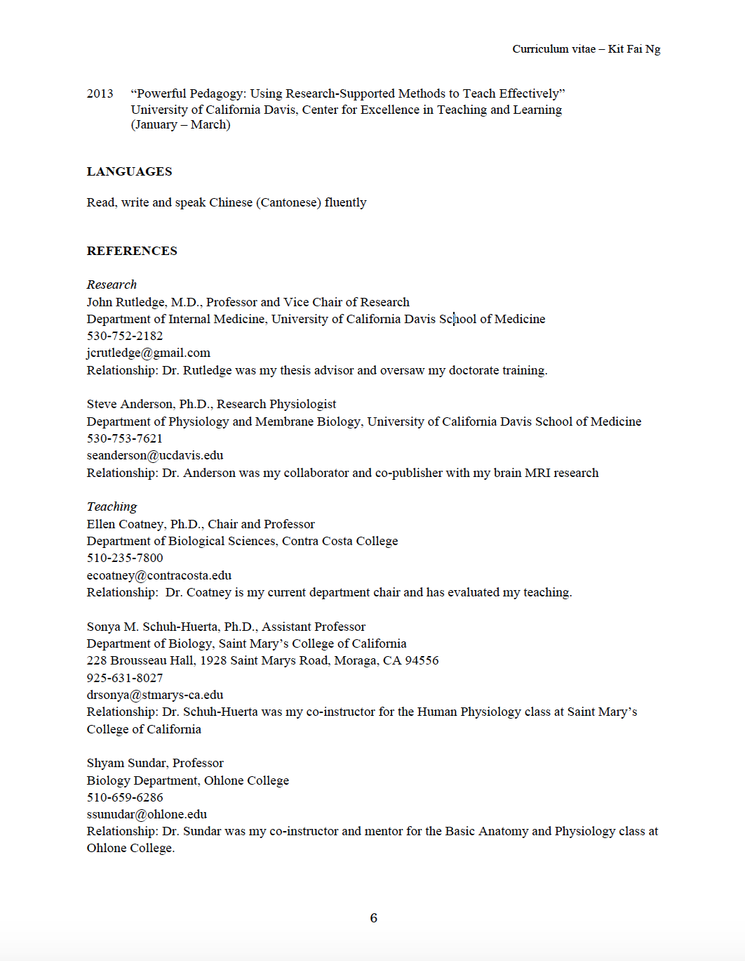
Teaching cv

Slide 36
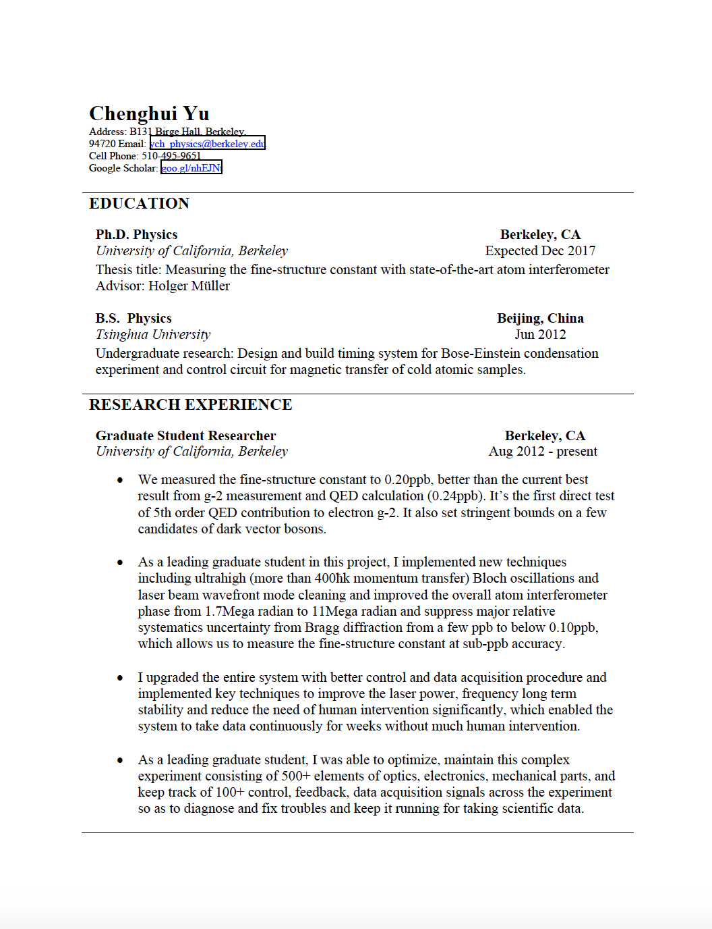
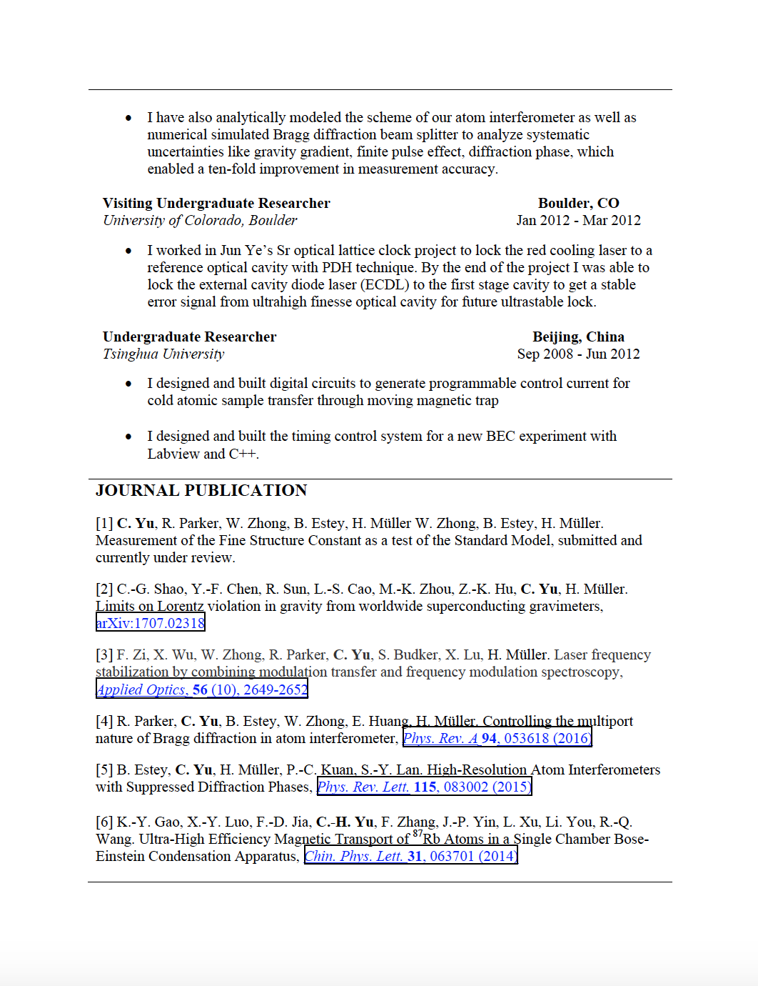
Research CV

Slide 37
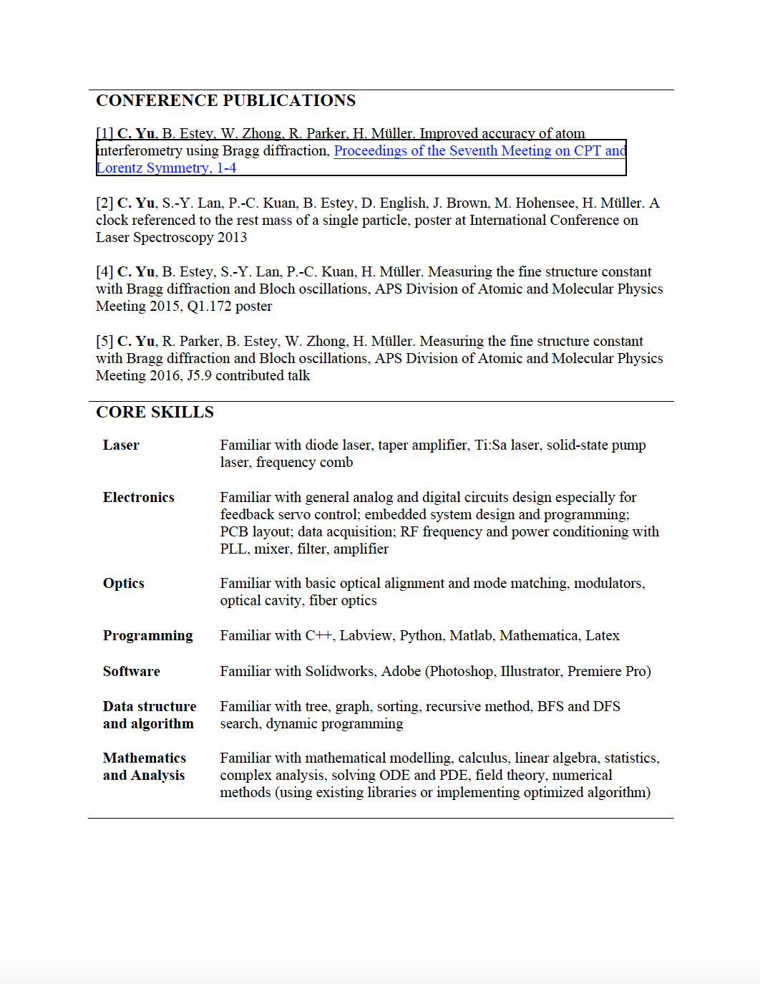
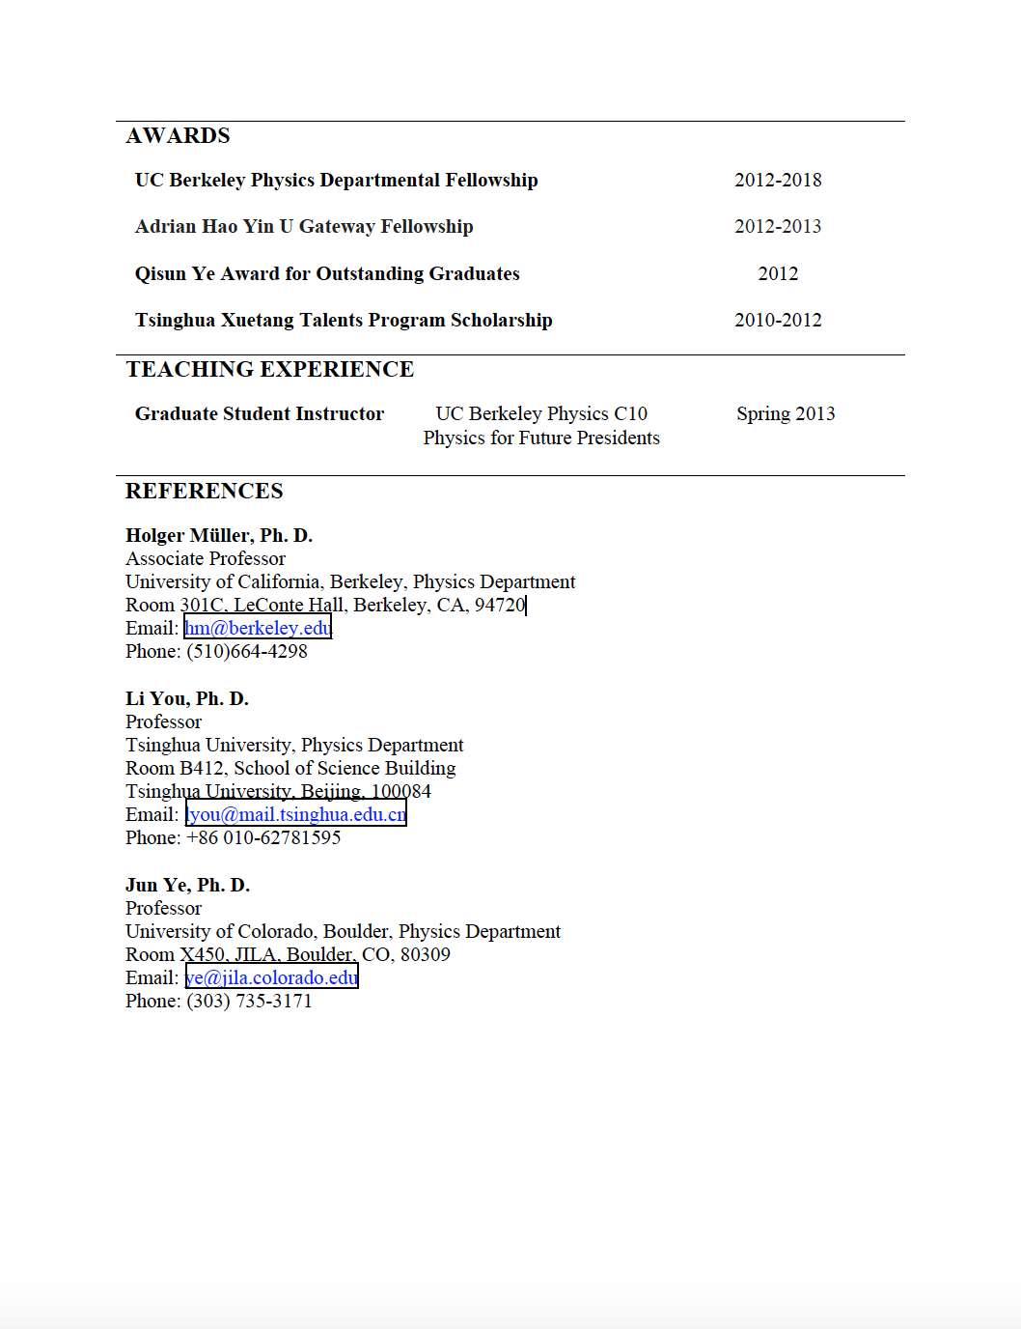
Research CV

